Slide 1

Engineering Analysis Presentation
The Ångströnomers
Economic Device to measure In-Plane Thermal Conductivity

Slide 2
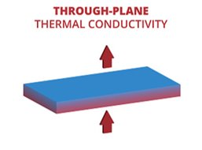

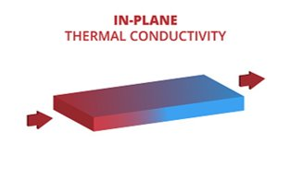
Thermal Conductivity
Thermal Conductivity: The degree to which thermal energy is transported across a temperature gradient
Q = heat transferred
d = distance between two isothermal regions
A = area
ΔT = change in temperature
Critical for work in Thermal Management
Low-profile electronics require in-plane solutions
  Requires characterization of novel, anisotropic materials
Notes:
Thermal Conductivity: The degree to which thermal energy is transported across a temperature gradient
Through-plane: travels through a material
Most current test methods are through-plane
In-plane: travels laterally across material
Companies are trying to move heat laterally, need new materials for thermal management solutions
In-plane thermal conductivity is key, especially in novel, anisotropic materials
Laser flash analysis (LFA) is the leading option for in-plane testing, but comes with drawbacks
Expensive: DXF 200+ costs $130,000
Not strictly in-plane

Slide 3
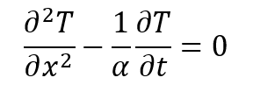
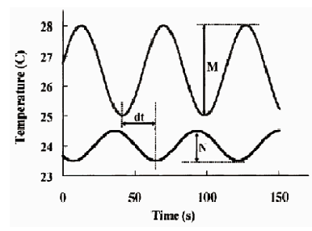
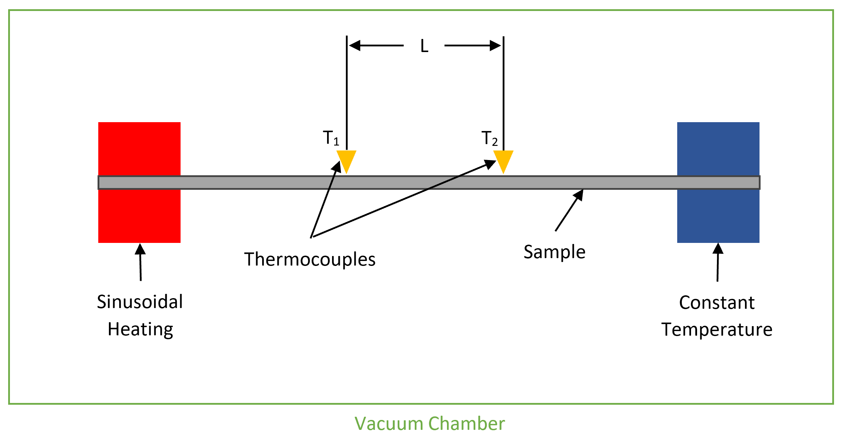
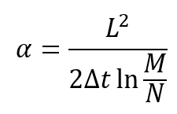
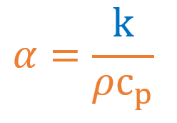
The Ångström Method
Our theoretical backbone
Relies on the validity of the 1-D Heat Equation:
Setup
Thermocouple Readout

Slide 4
Subsystem Challenges
Frame / Vacuum Chamber – How can we minimize convection?
Clamping – How can we reliably fixture our samples?
Heating / Electronics – How can we achieve controlled, sinusoidal heating?
Heat Sink – How can we maintain a constant temperature boundary condition?
Thermocouples – How can we achieve equal mechanical pressure?
Data Analysis – How can we most accurately output our data?
Notes:
Vacuum is both a solution and a challenge

Slide 5
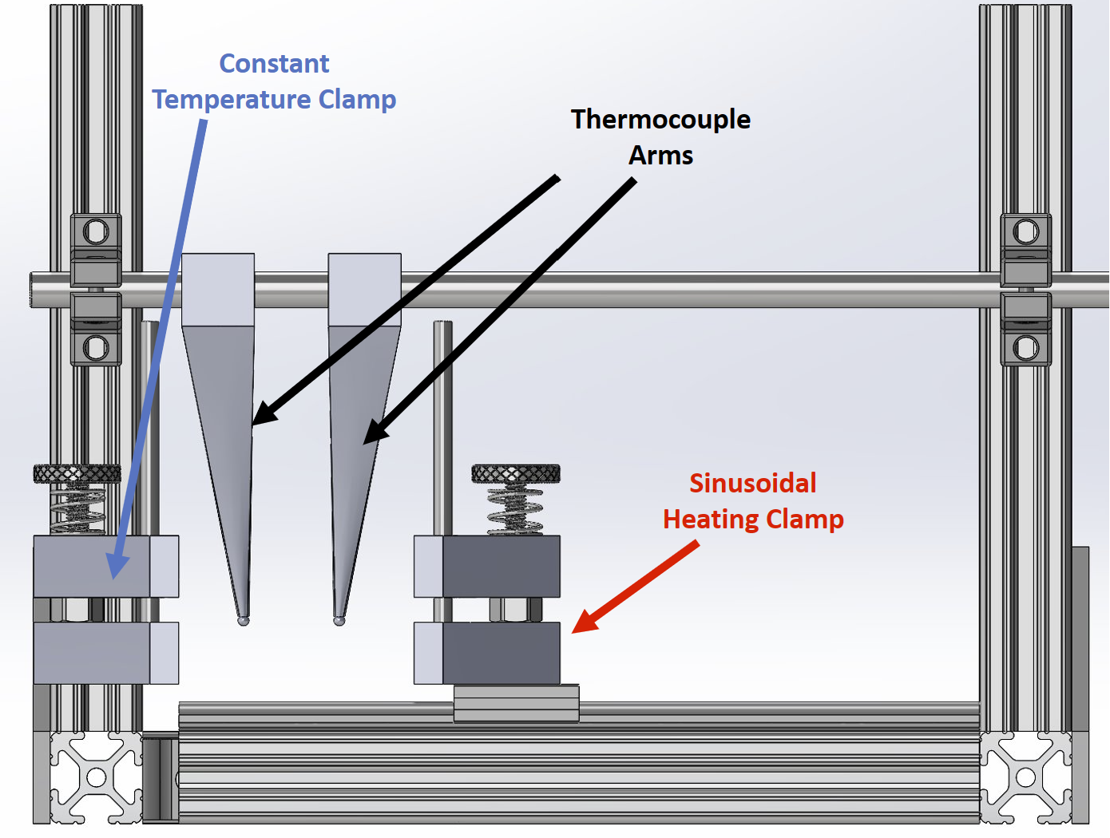
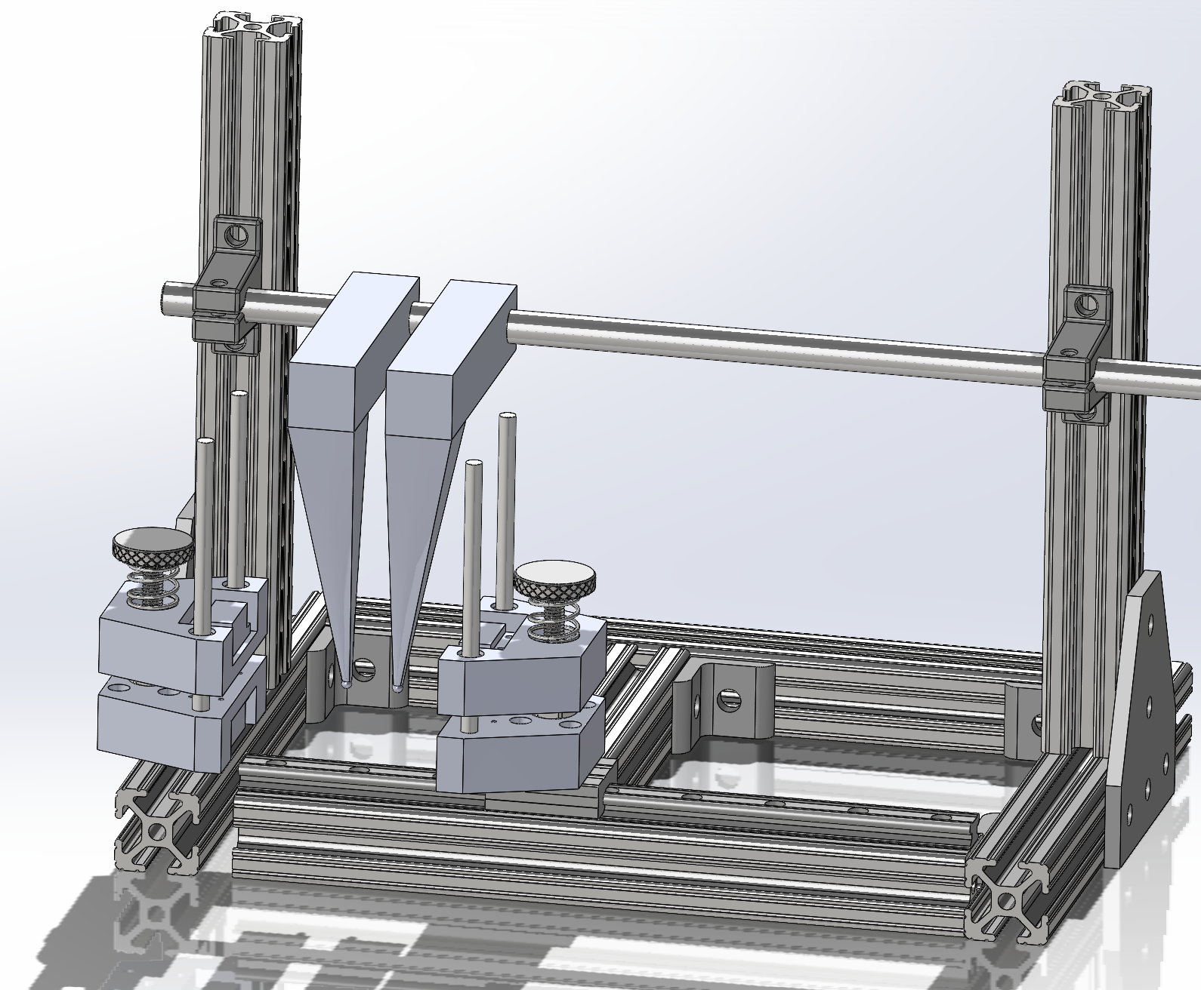
CAD Model
CAD Model

Slide 6
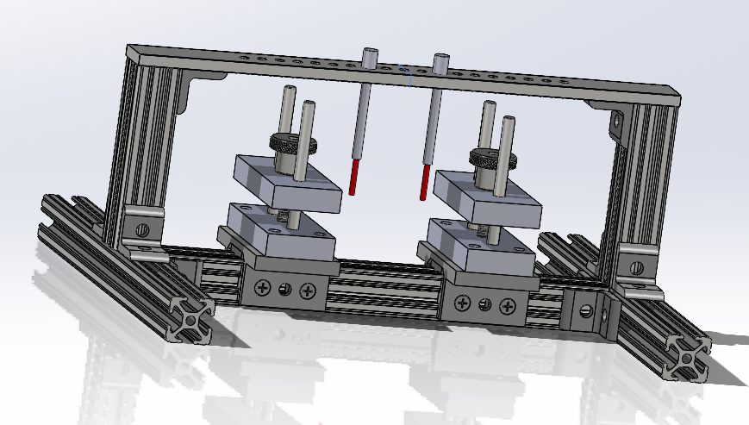
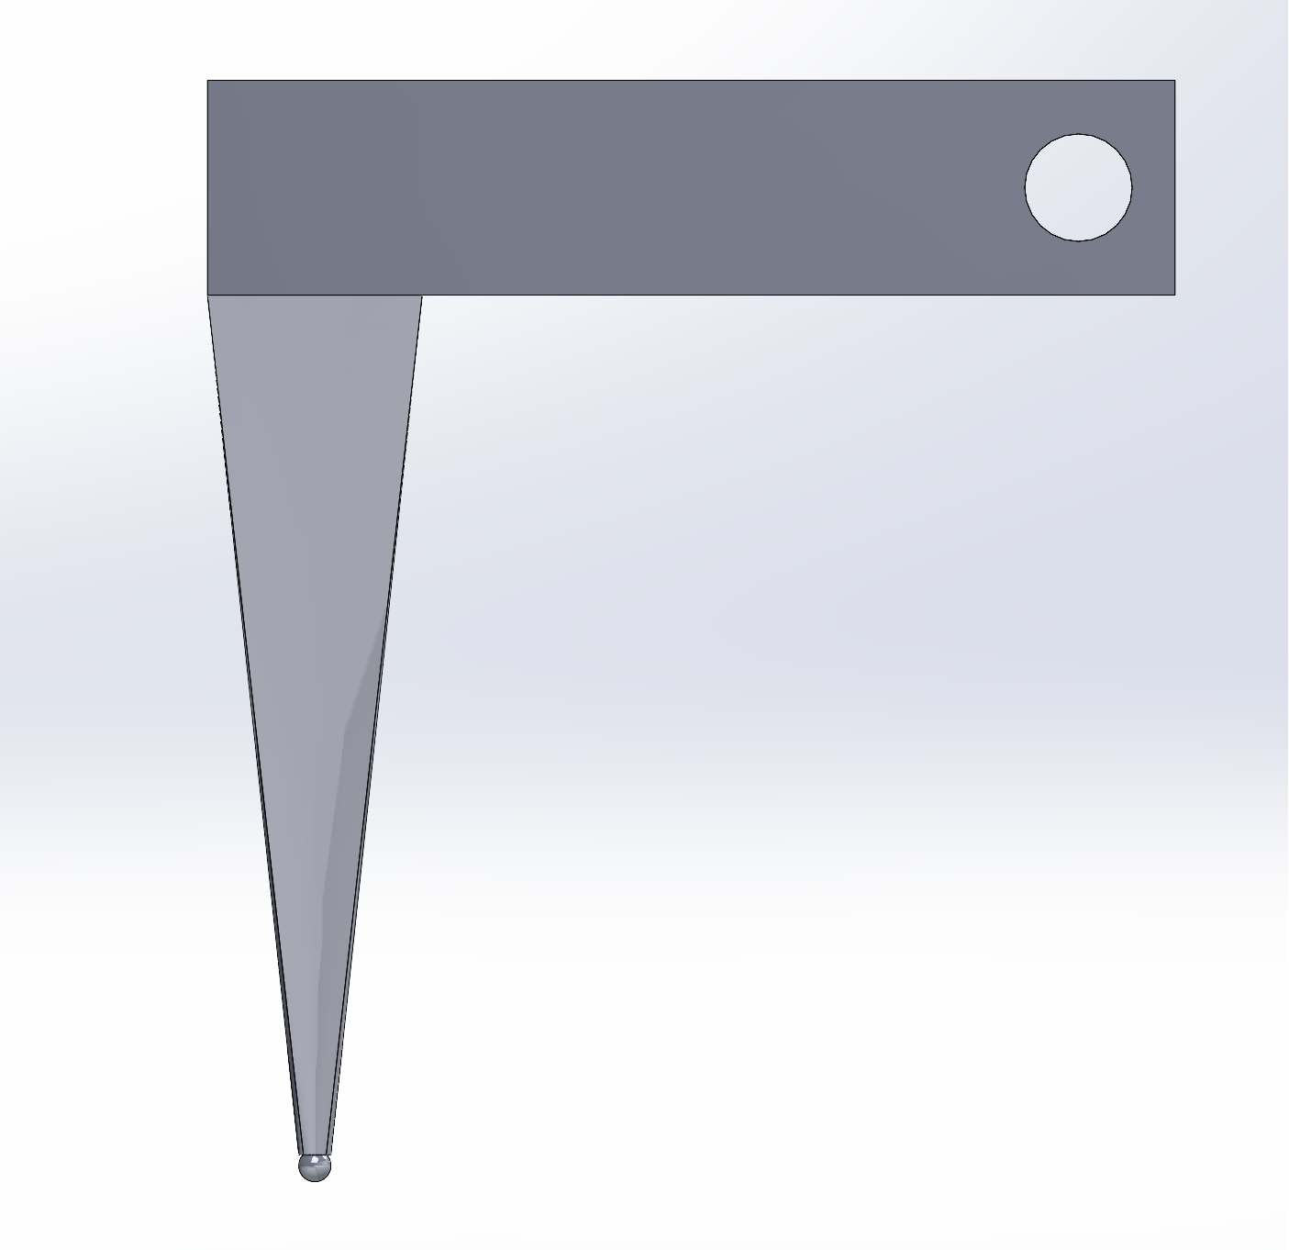
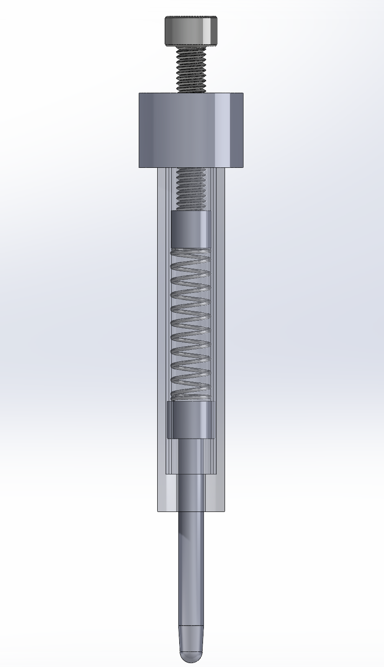
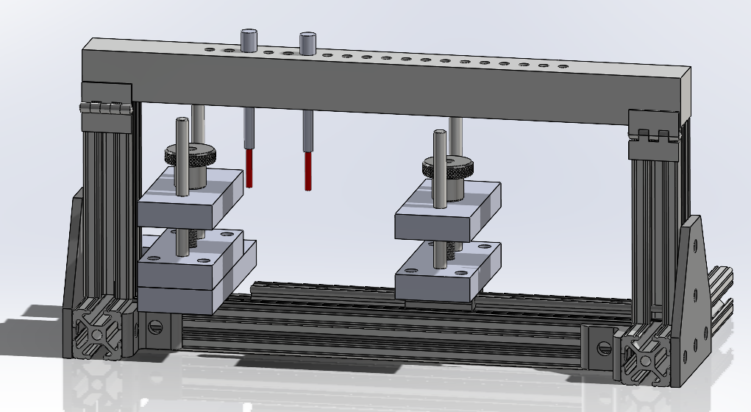
CAD Model – Design Iterations
CAD Model

Slide 7
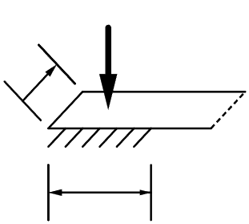
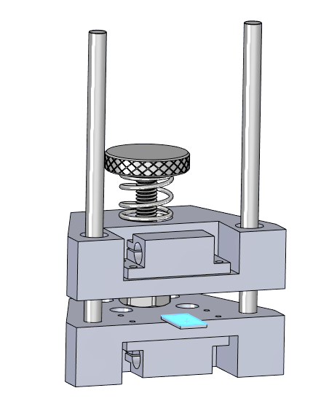
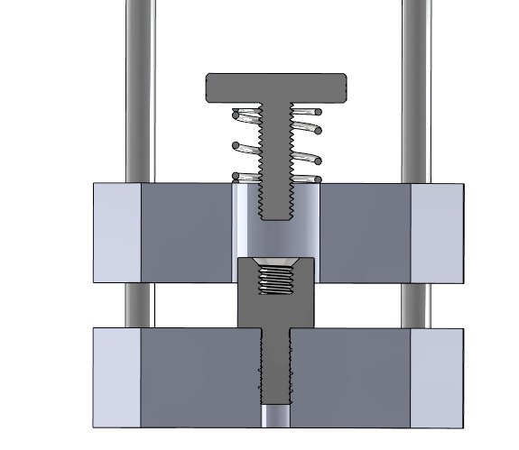



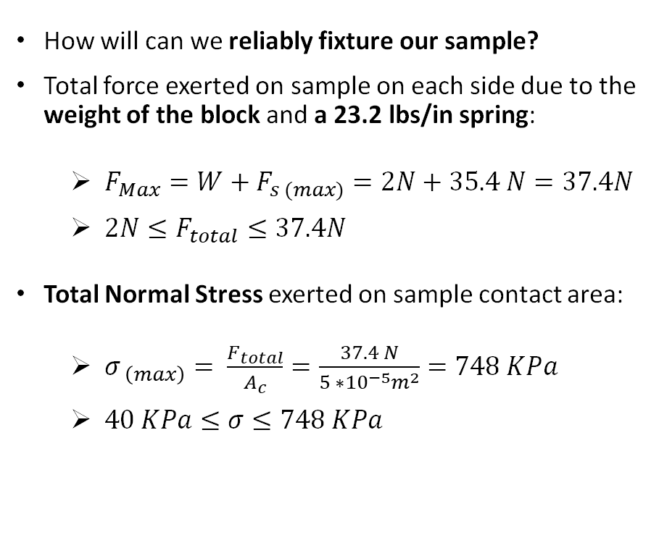
Sample Forces
Clamping Forces
  How will can we reliably fixture our sample?
  Total force exerted on sample on each side due to the weight of the block and a 23.2 lbs/in spring:
    $F_{Max}=W+F_{s (max)}=2N+35.4 N=37.4N$
    ${2N≤F}_{total}≤37.4N$
    Total Normal Stress exerted on sample contact area:
      $σ_{ \left(max\right)}= \frac{F_{total}}{A_{c}}=\frac{37.4 N}{5 ∗{10}^{−5}m^{2}}=748 KPa$
      $40 KPa≤σ≤748 KPa$
$$F_{total}$$
$$10 mm$$
$$5 mm$$

Slide 8
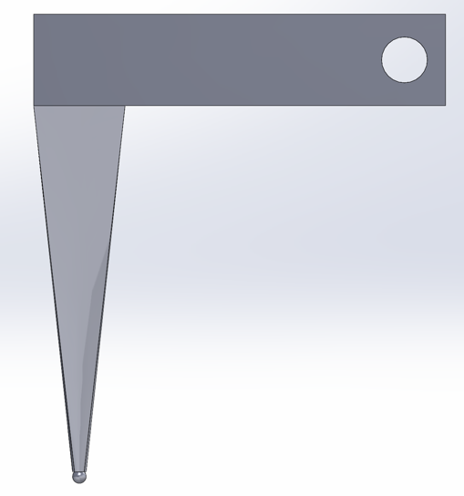
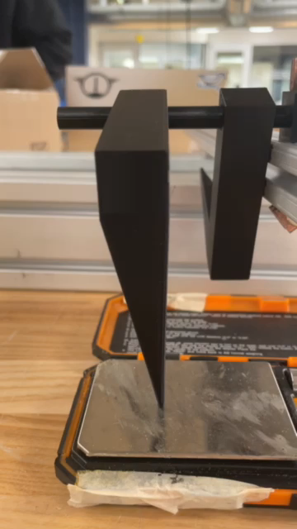
Thermocouple Housing Selection
Thermocouple Housing
Performed test to measure consistency of applied pressure
  Both designs took >1 minute to settle on a value
  Sources of error for cantilever can be more easily accounted for
  Decision: Cantilever design
Notes:
Another important aspect of our design is our thermocouple housing, which must maintain equal mechanical pressure for the 2 thermocouples placed along the sample. One proposed design was a spring-loaded mechanism where the turn of a screw by the user compresses a spring, thereby applying pressure to the thermocouple bead secured at the bottom. Another design was a much simper cantilever arm, which is secured about a shaft placed further back behind the sample. Equal pressure is achieved through the equal weight of each arm and, if needed, applying weights of known value on top of the arm.
We performed a test on 3D printed prototypes of both designs to quantify the consistency of the pressure applied. We found that both designs took over 1 minute to settle to a stable applied force, which is not ideal for a device where we want the user to reliably know at any point in time what the applied force is. We thought about what was causing this drift for each design and how we could improve upon it in future iterations. Ultimately, we decided on pursuing the cantilever design. Its drift is likely caused by lack of axial constraint along the shaft in our prints (as shown in this video). This can be easily designed for by using a bearing along the shaft in the final design. The spring-loaded mechanism, in contrast, has other, more complex factors that must be accounted for to ensure a constant, reliable force is achieved every time.

Slide 9
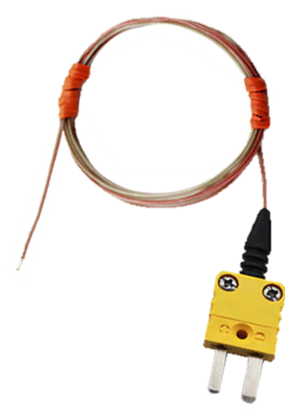
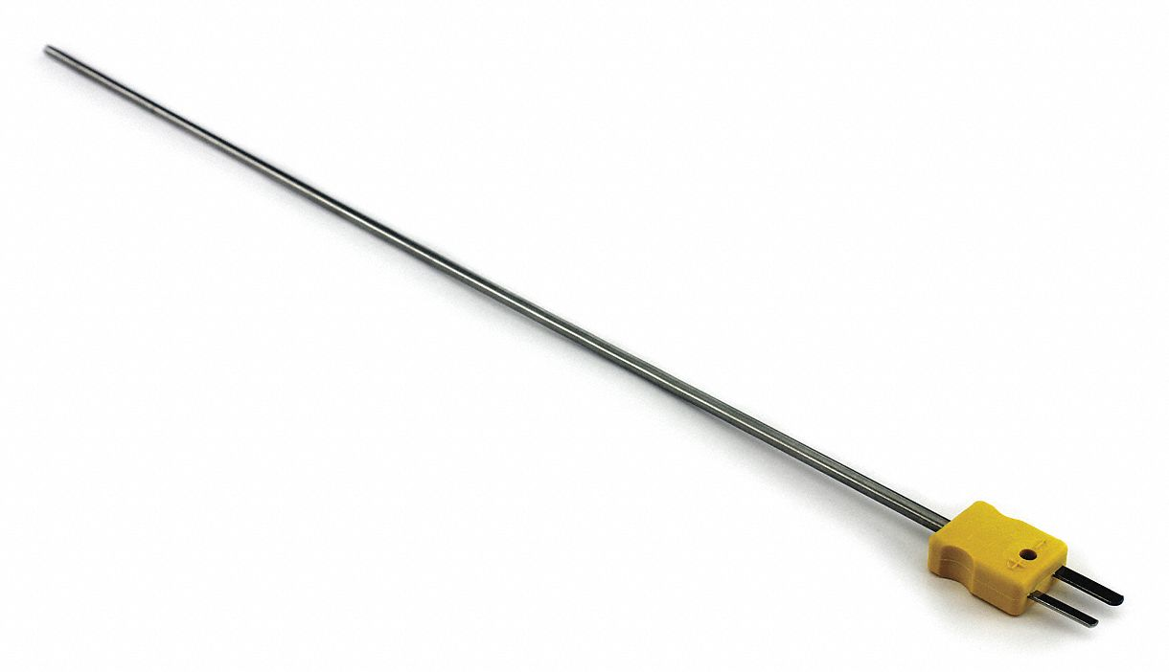
Thermocouple Selection
Thermocouple Selection
Bead-type provides suitable geometry for measuring temperature at a single point
  More flexible than probe-type
  Not susceptible to self-heating like thermistors

Slide 10
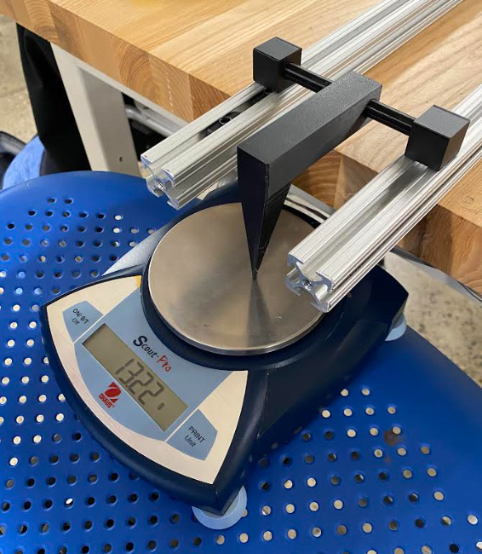
Notes:
Value takes time to settle, and not consistent between identical tests
11/29 Test: both TC’s stayed at 14-15g for at least 1 minute

Slide 11
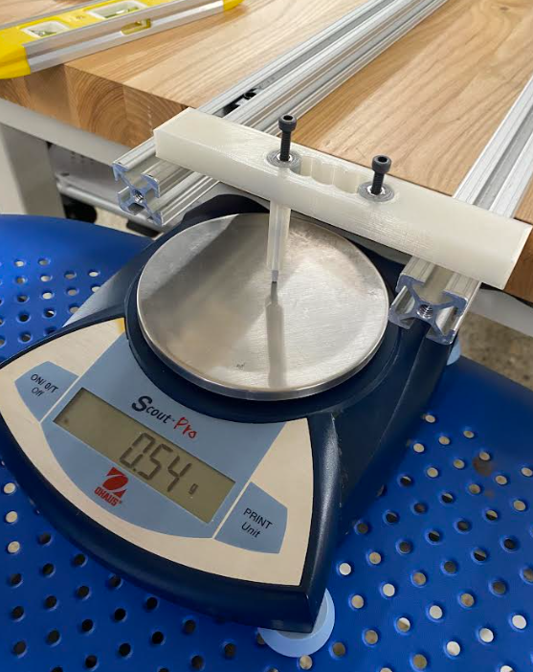

Slide 12
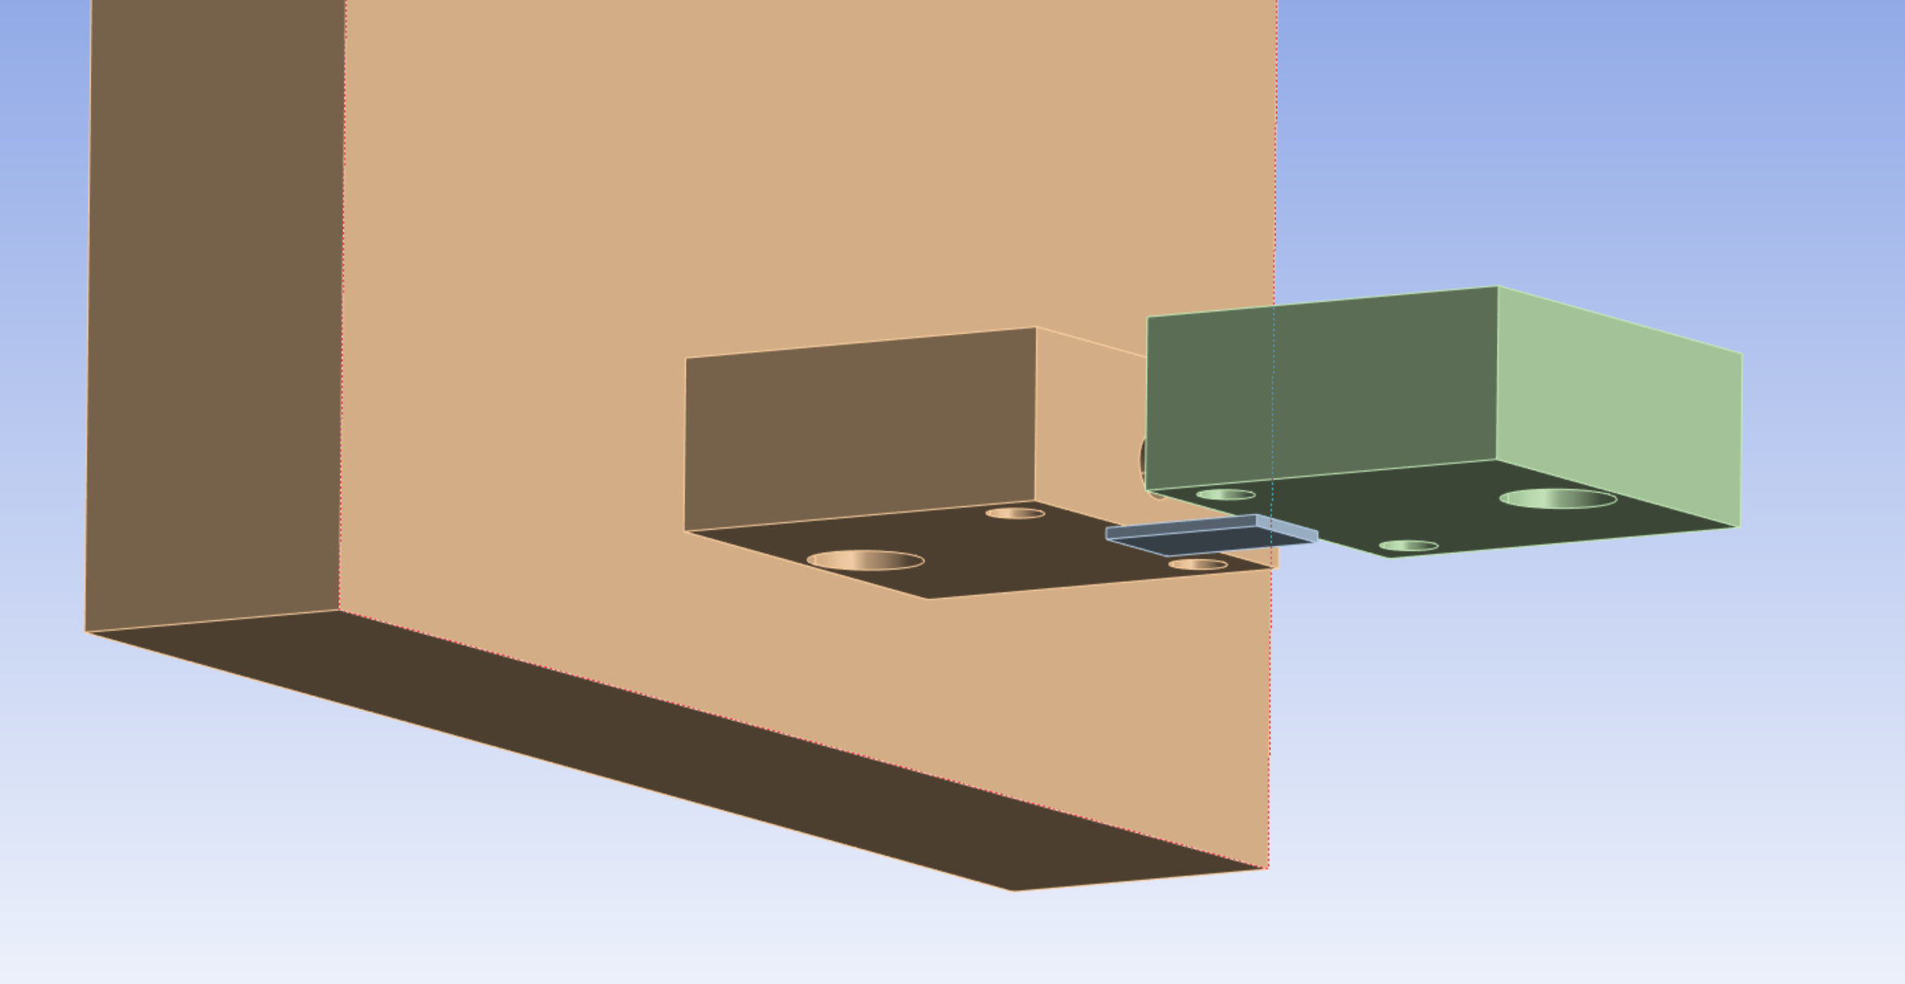
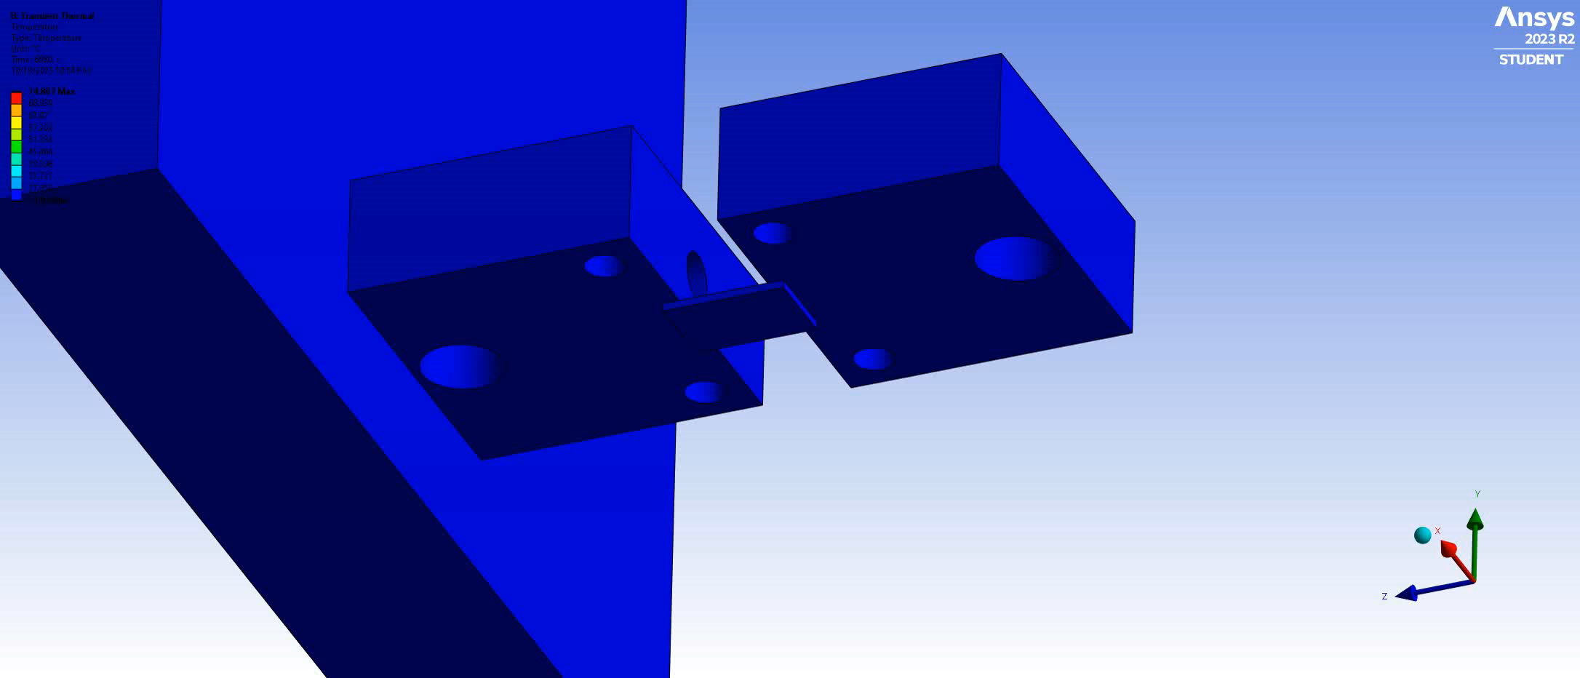
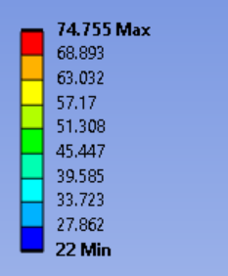
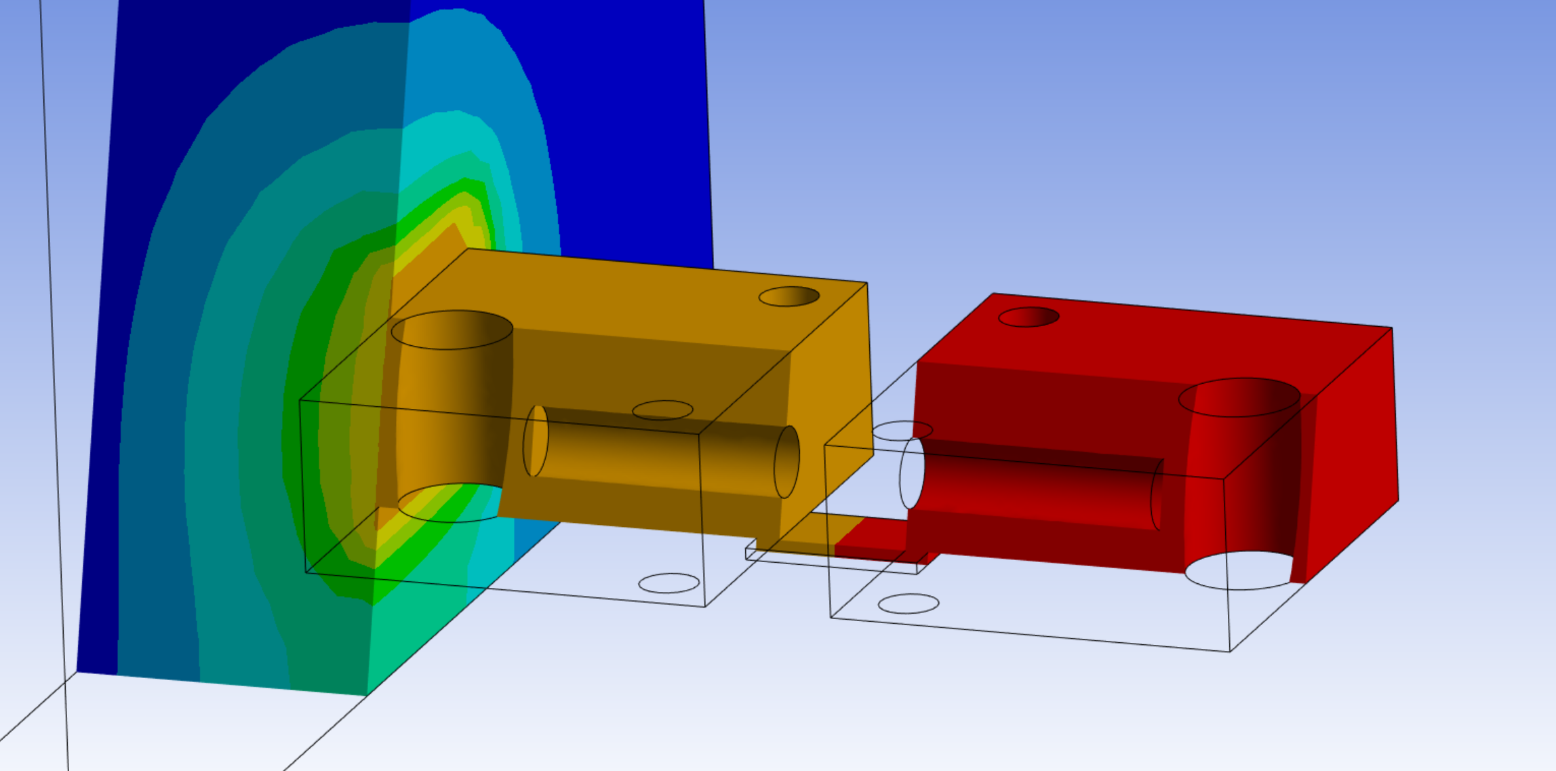
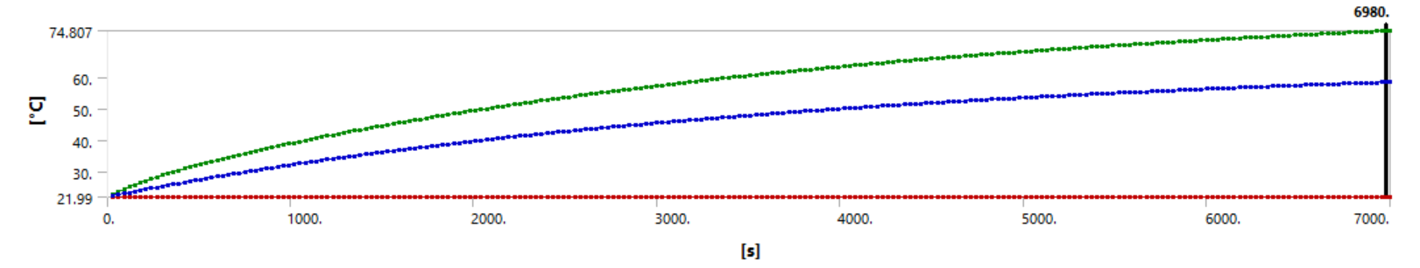
Ansys Simulations – Simple

Slide 13
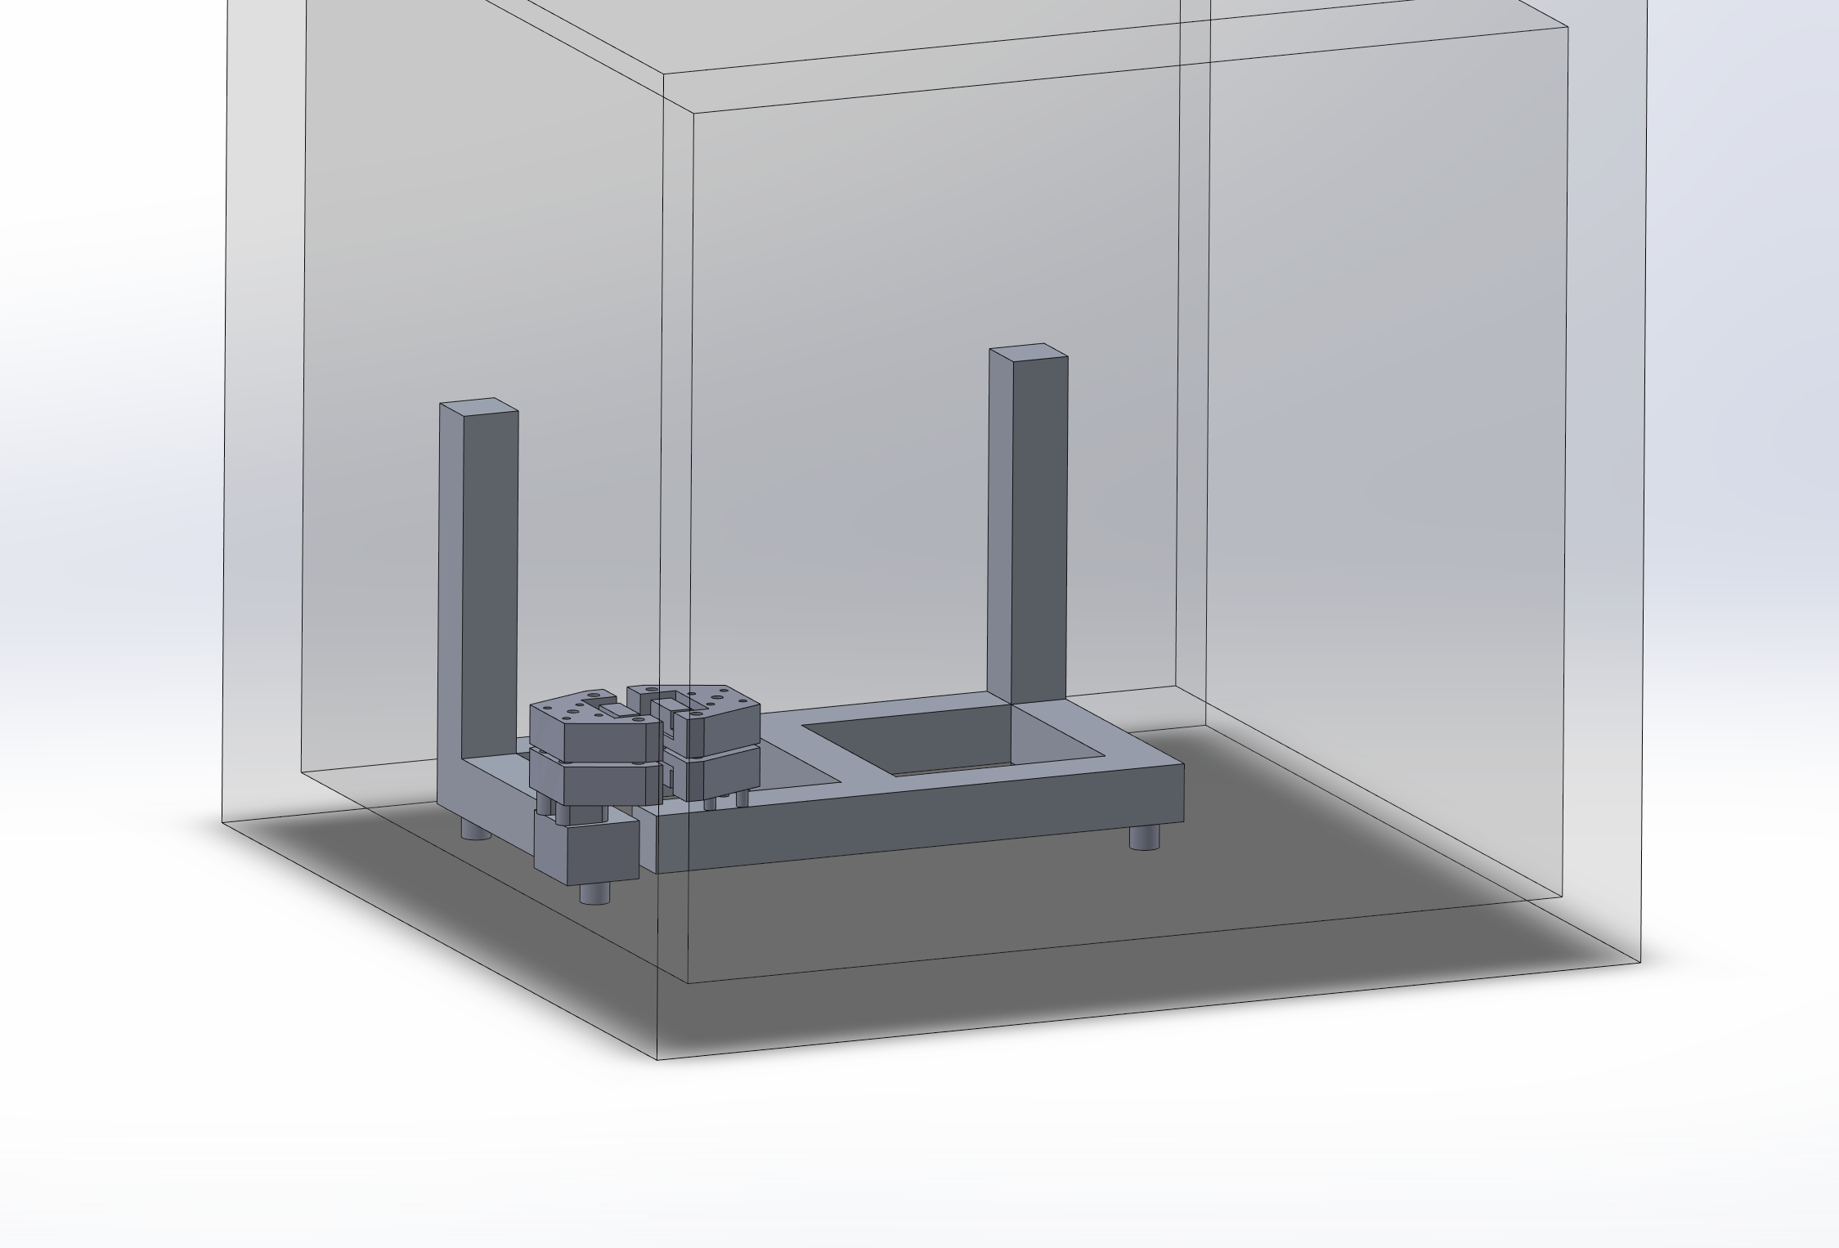
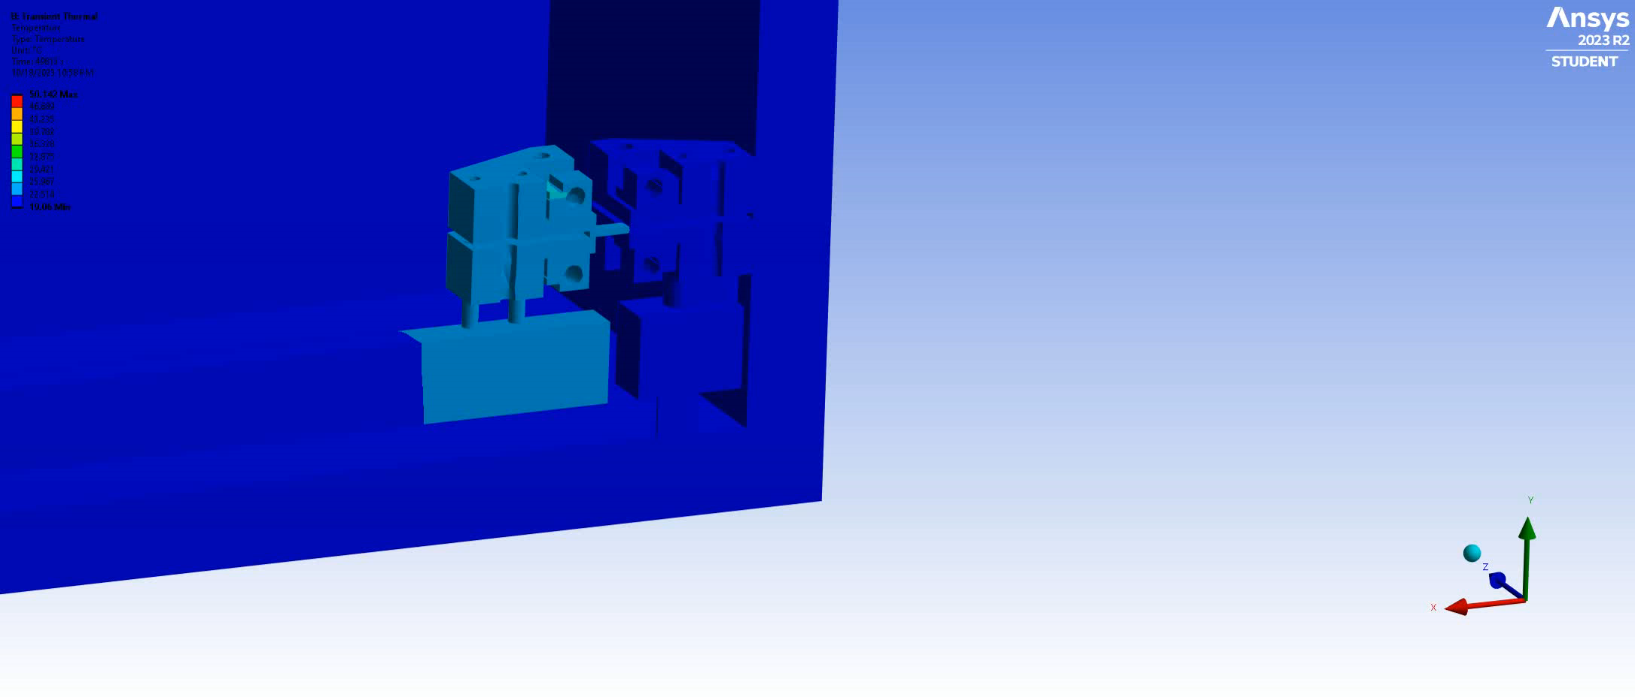
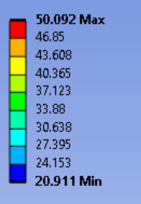
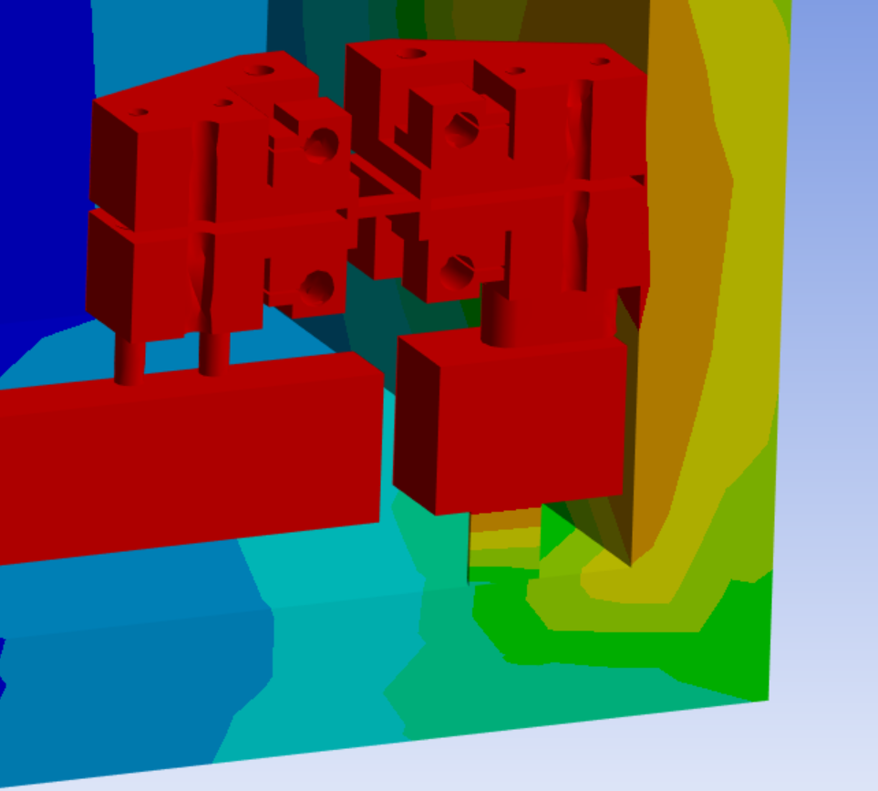
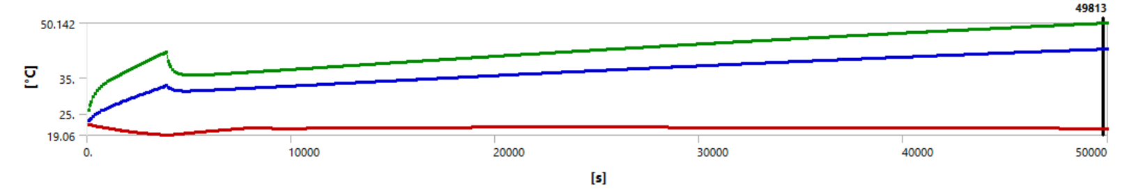
Ansys Simulations - Refined

Slide 14
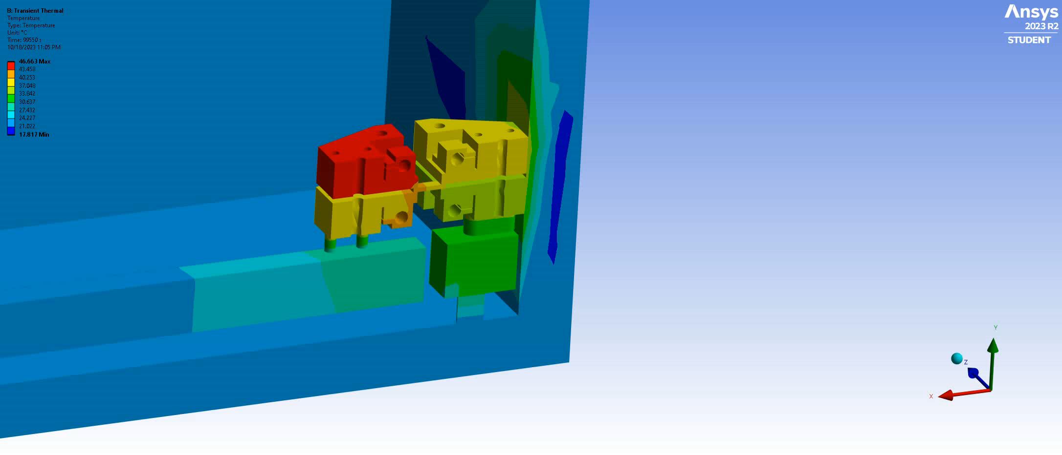
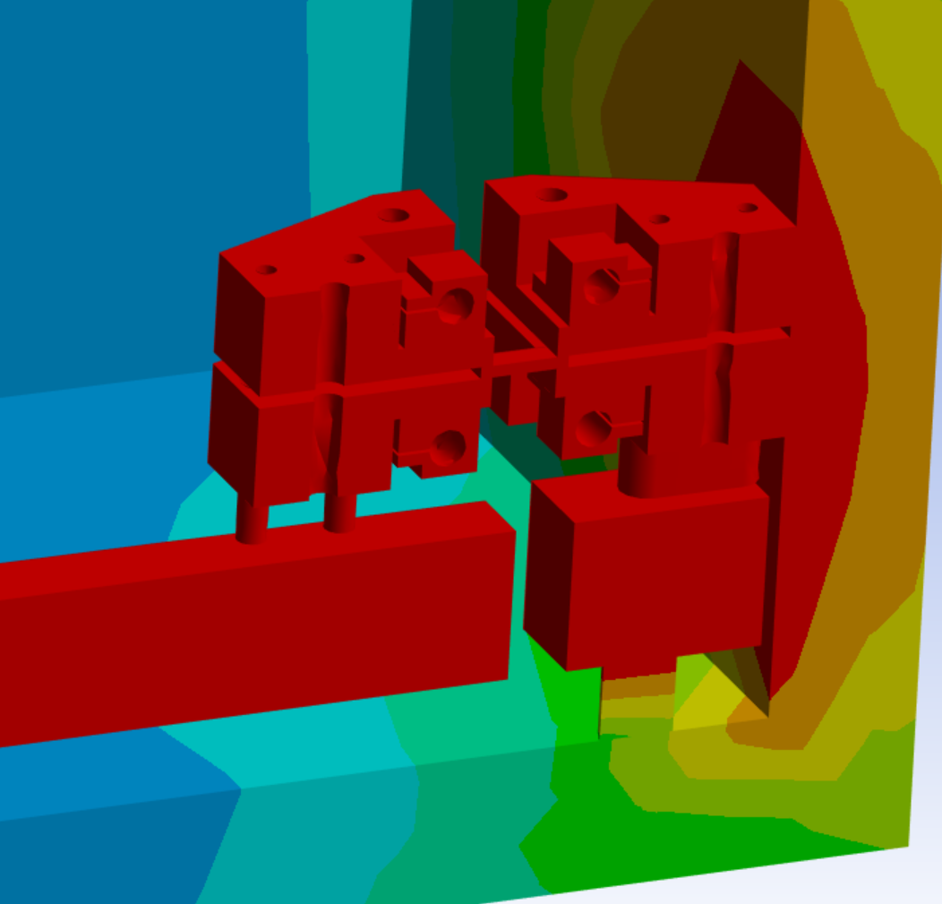
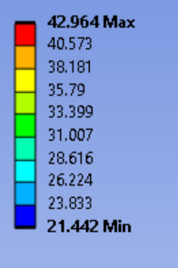
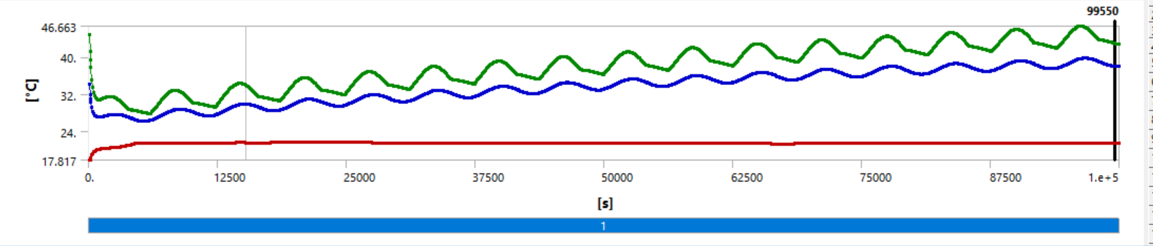
Ansys Simulations – Sine Wave

Slide 15
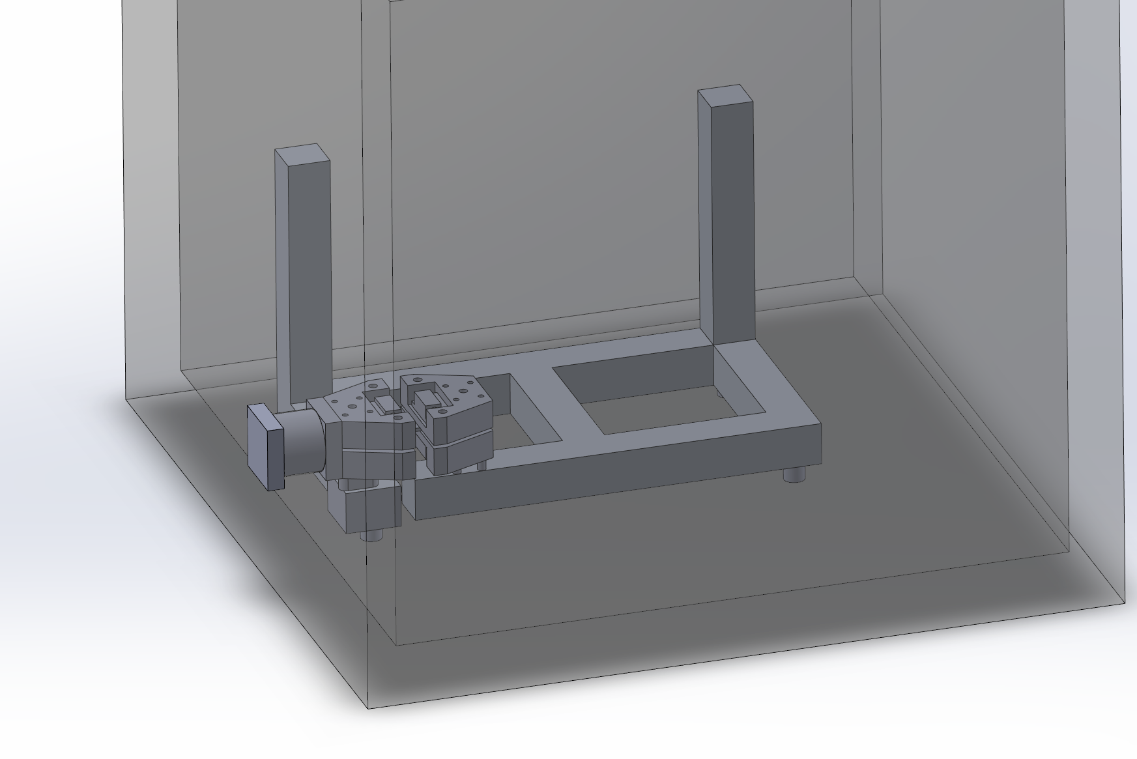
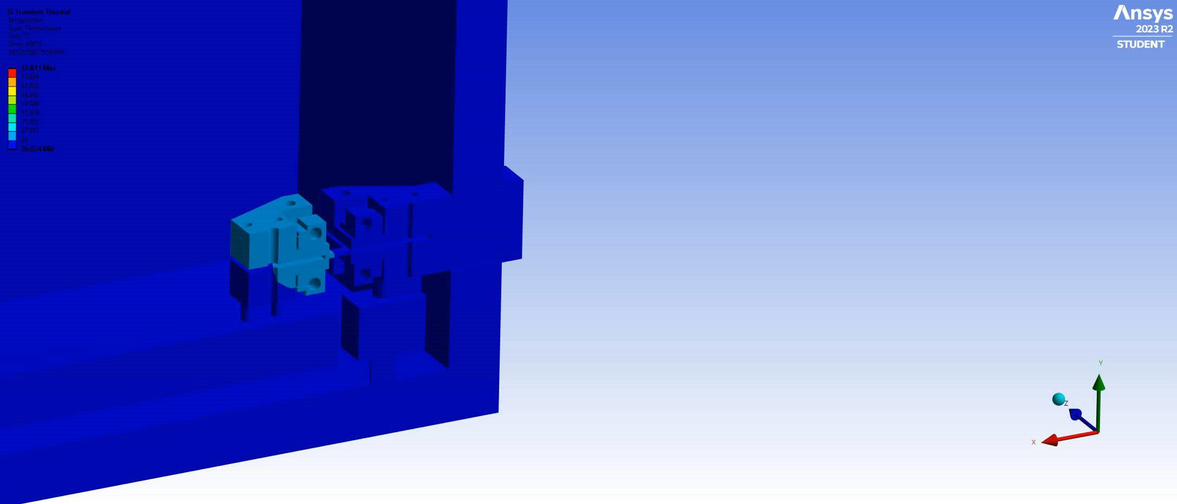
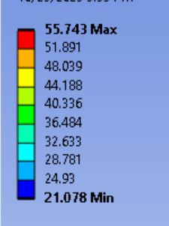
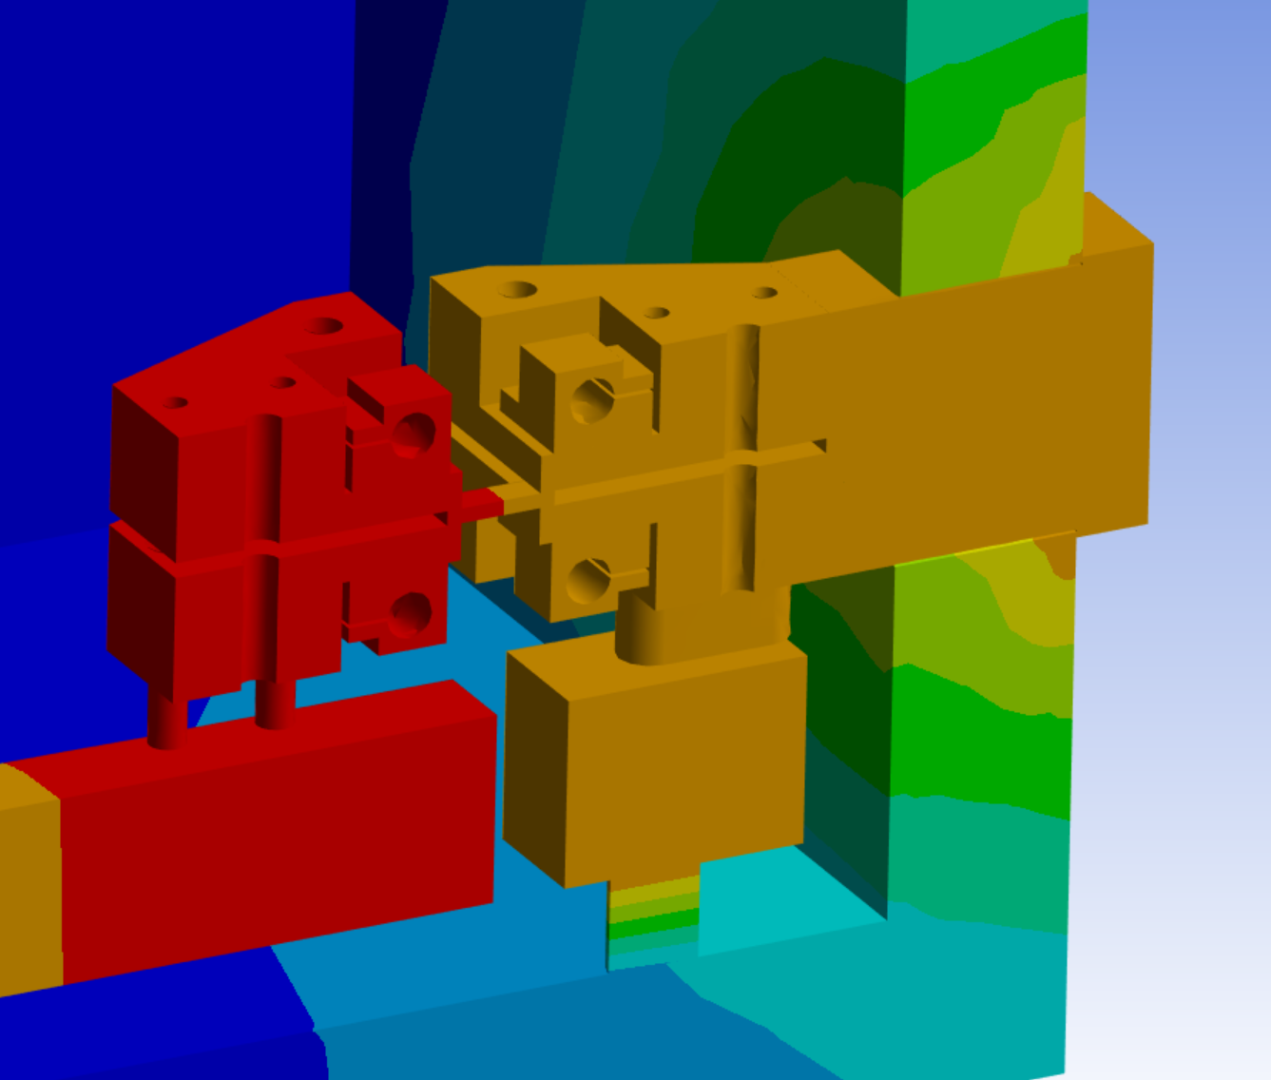
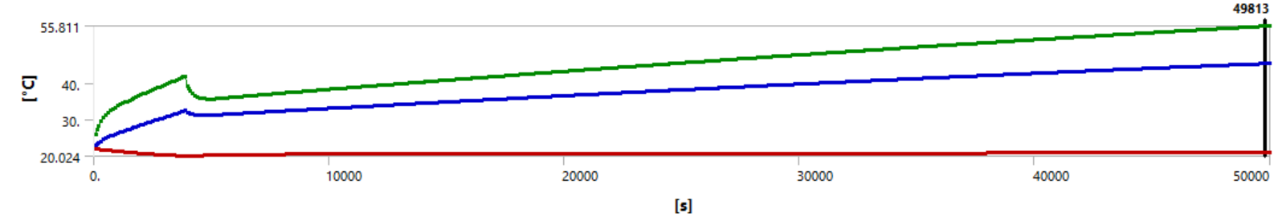
Ansys Simulations - Heatsink

Slide 16
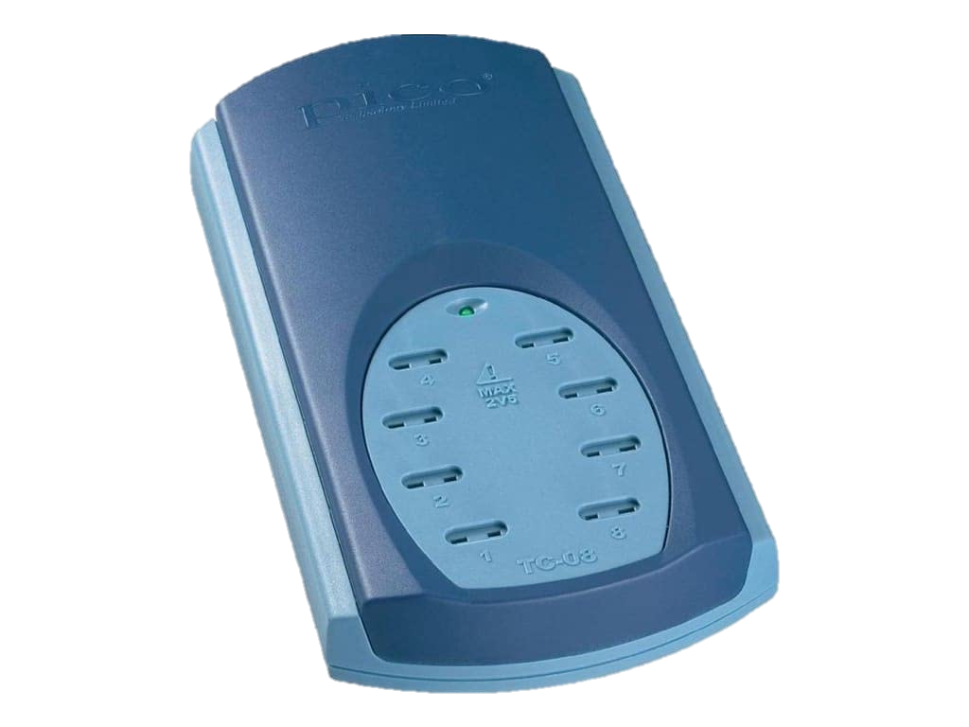
Data Collection
How can we ensure all data is collected?
DAQ Buffer Size | 15 Values
X Time Between Readings | 0.3 Seconds
Storage Time on DAQ Buffer | 4.5 Seconds
Should take a reading every 4.5 seconds to ensure data is not lost
Data Processing must be Fast

Slide 17
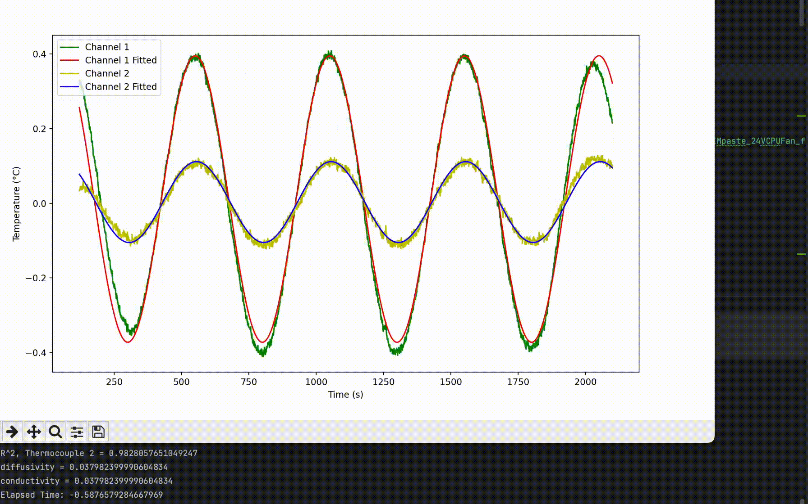
Data Collection
Current Data Processing takes
~0.6 seconds
Limited to a 4.5 second window to ensure data is not lost
Will ensure speed as features increase (Heater control, more TC, etc.)

Slide 18
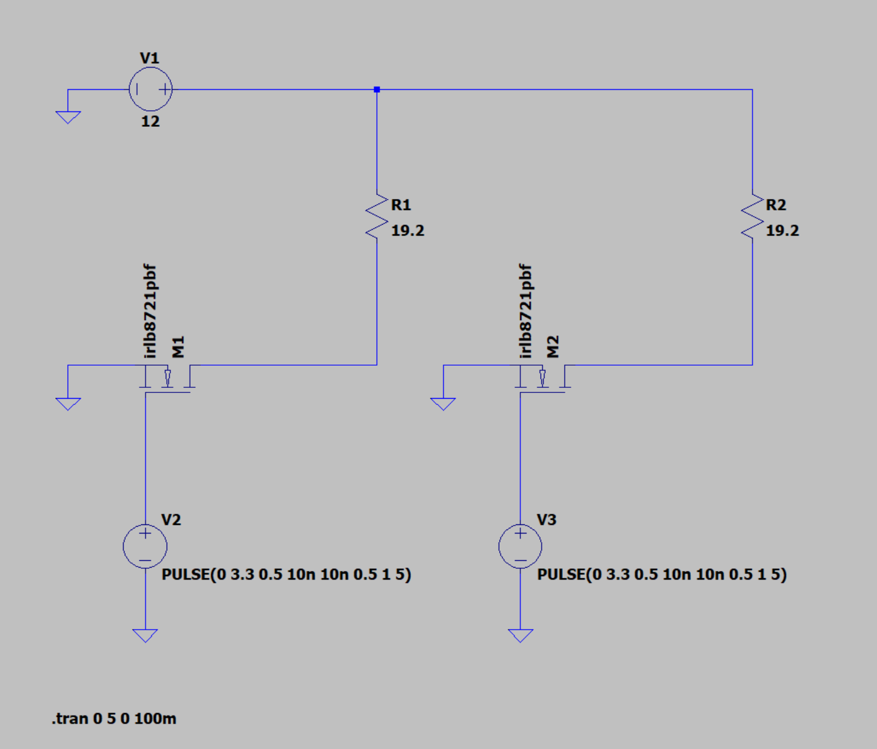
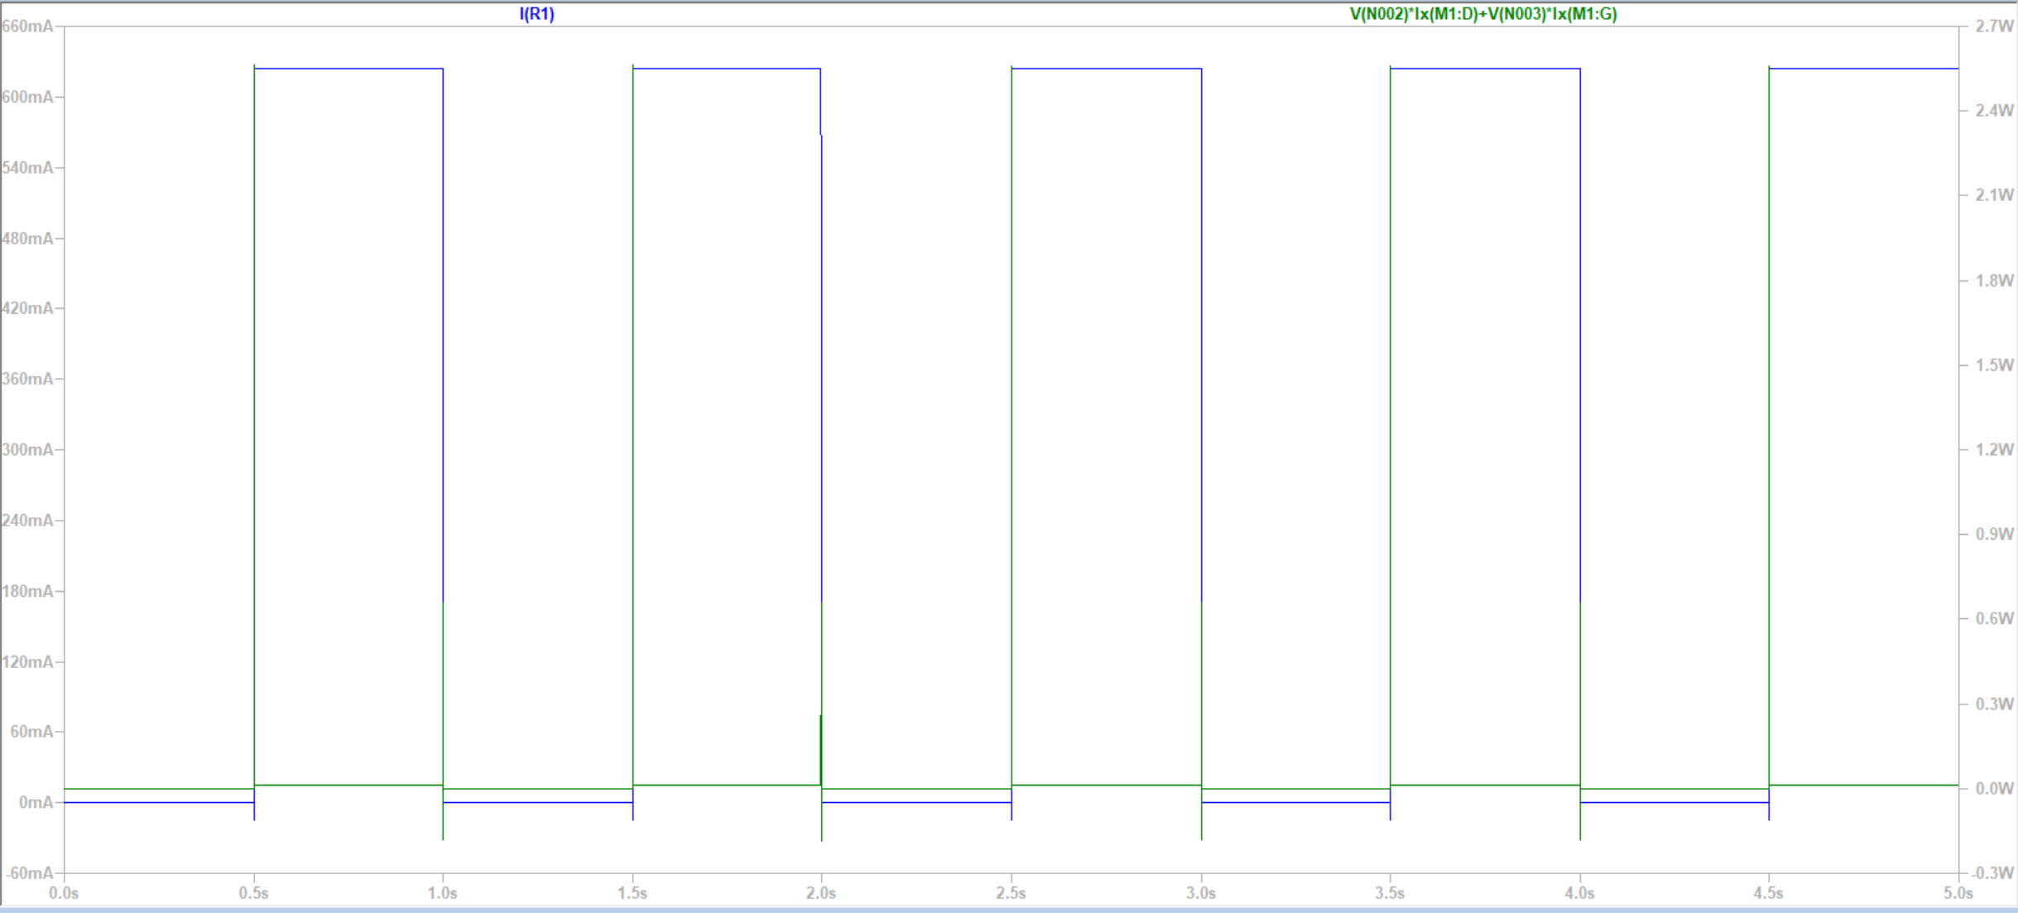
Electrical Simulation
Get an understanding of the switching behavior of our MOSFETs
Guide PCB Design

Slide 19
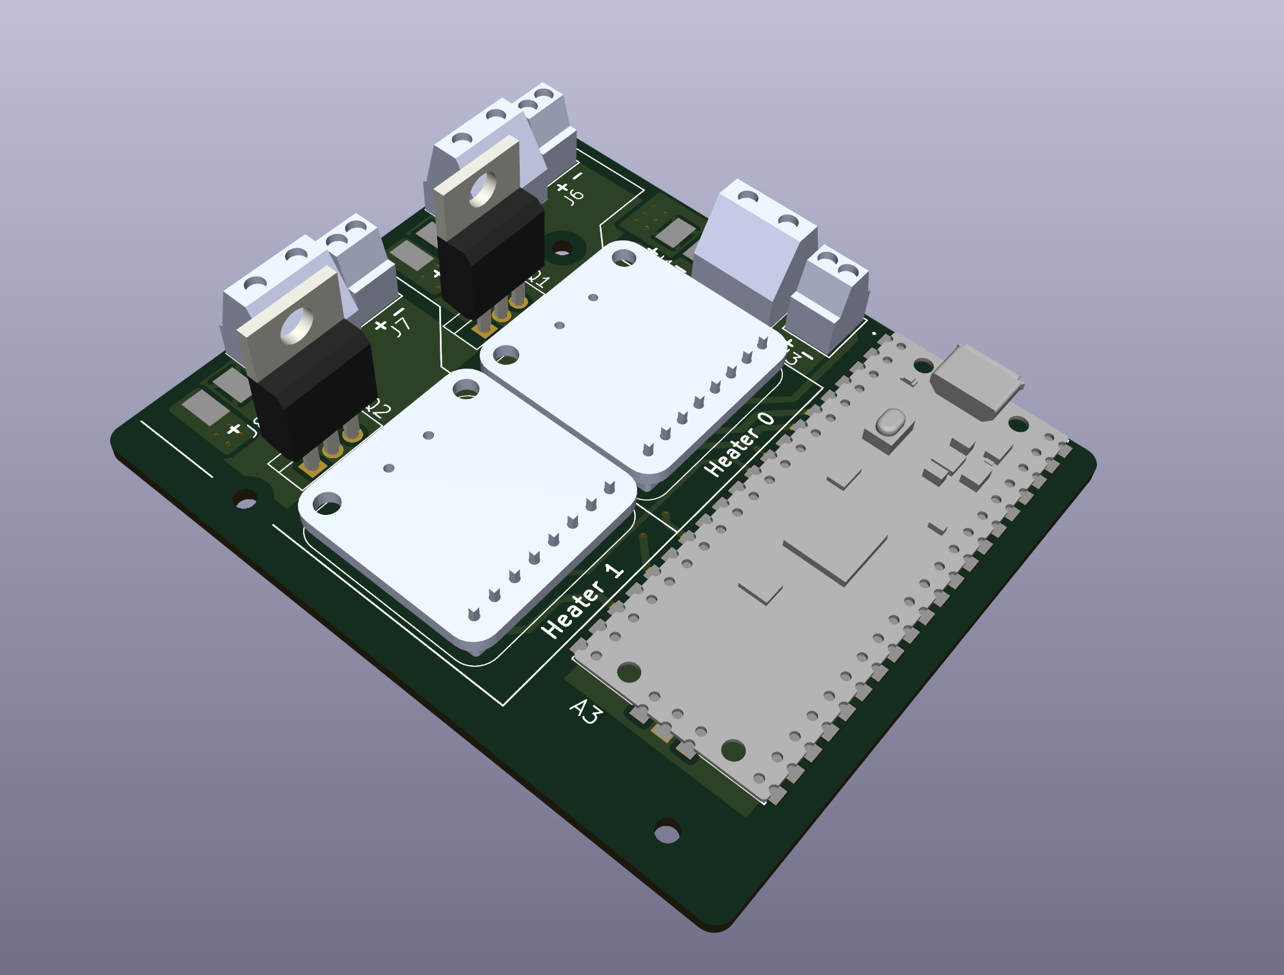
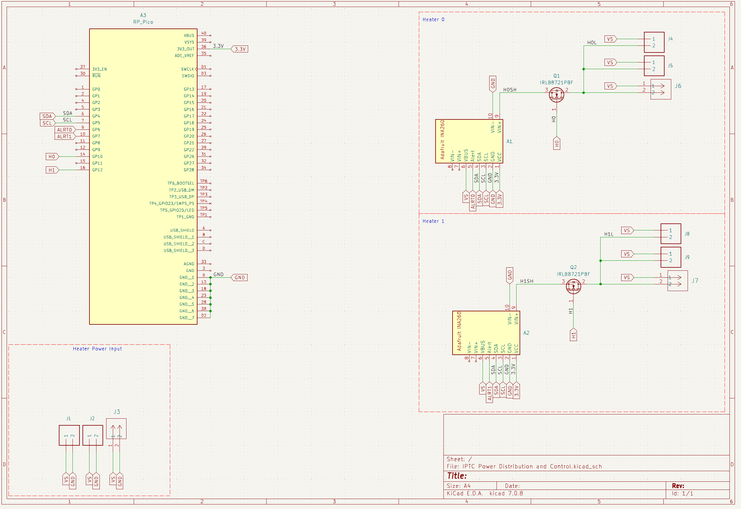
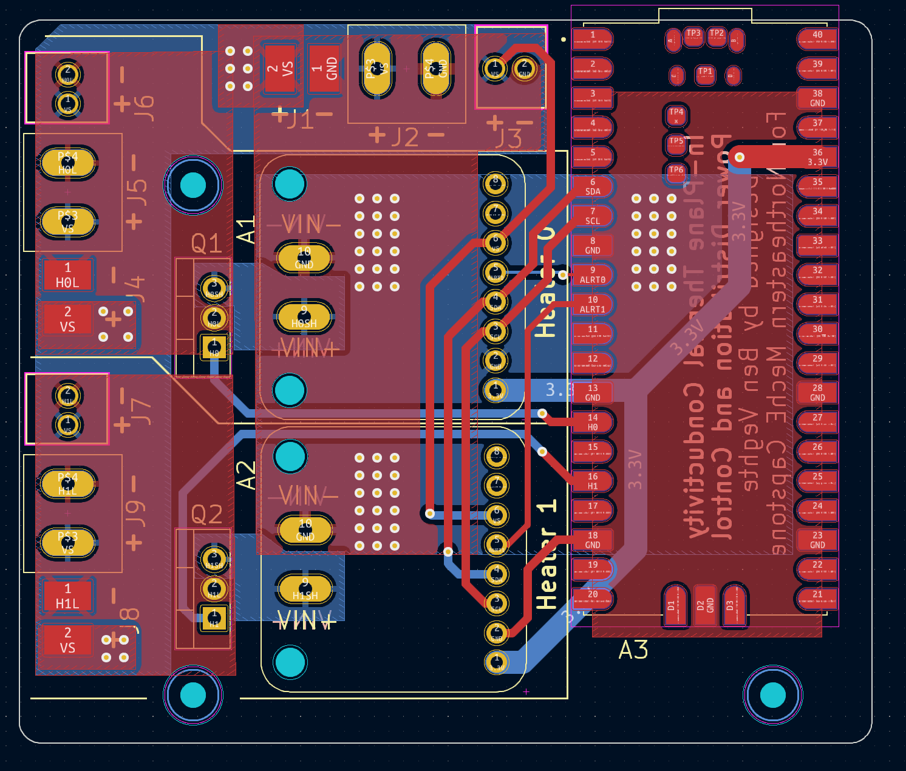
PCB Design
Simple soldering
Reduce risk of errors/shorts

Slide 20
Thank You!
Any Questions?

