Slide 1

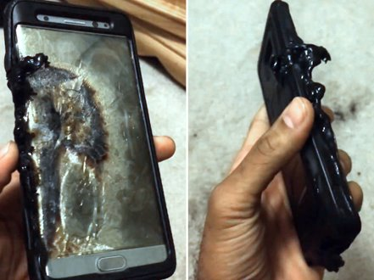
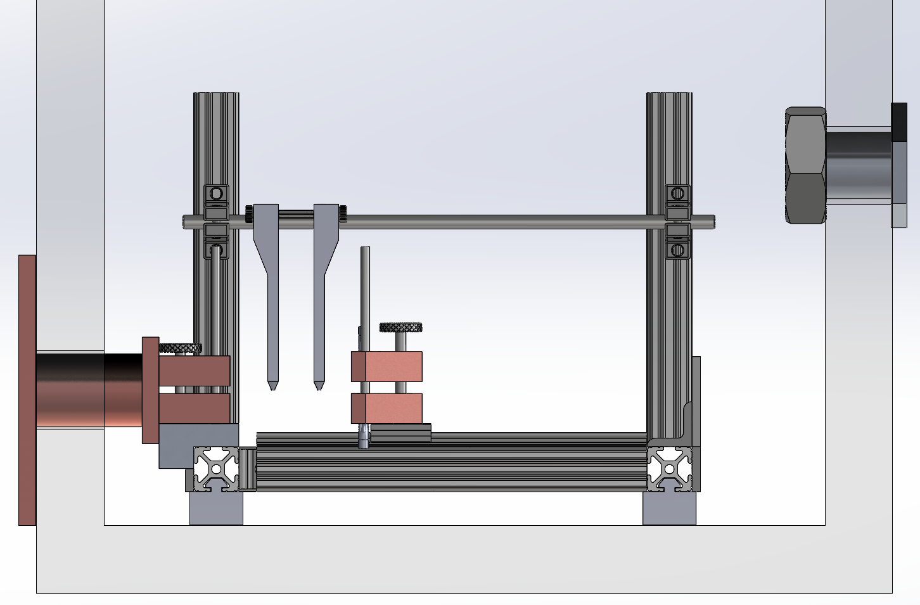
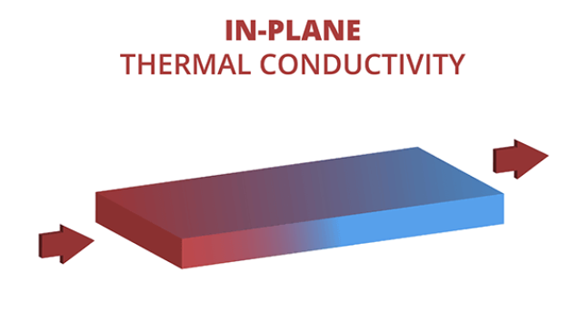
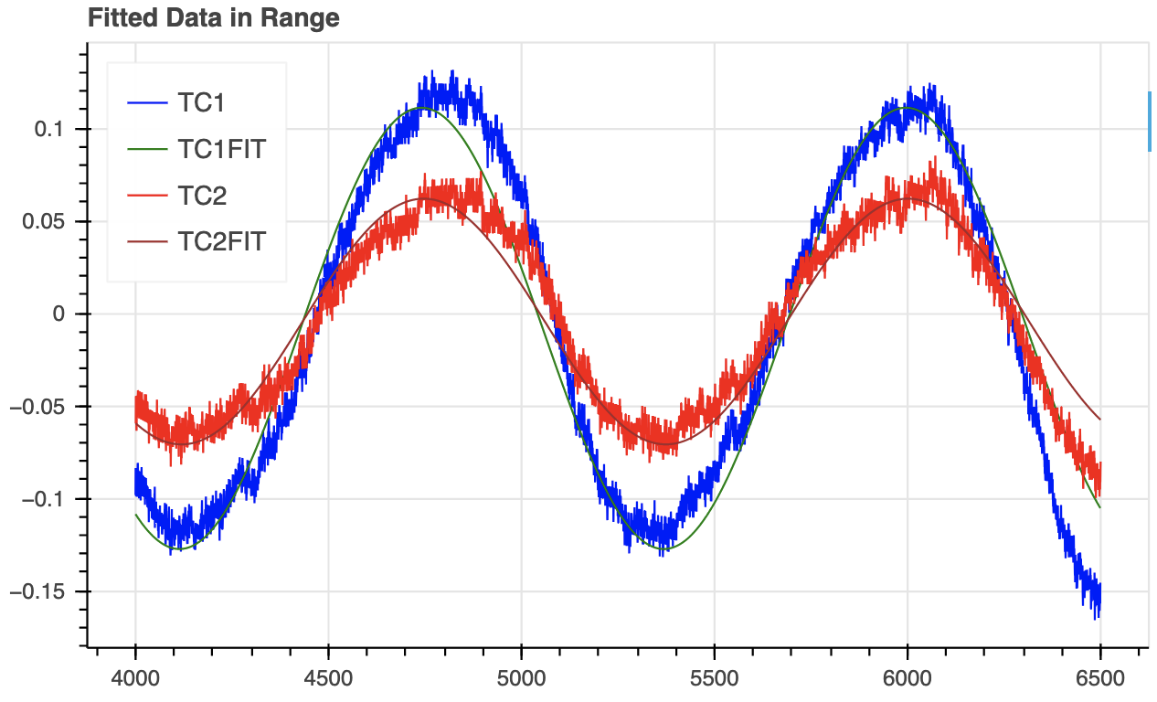
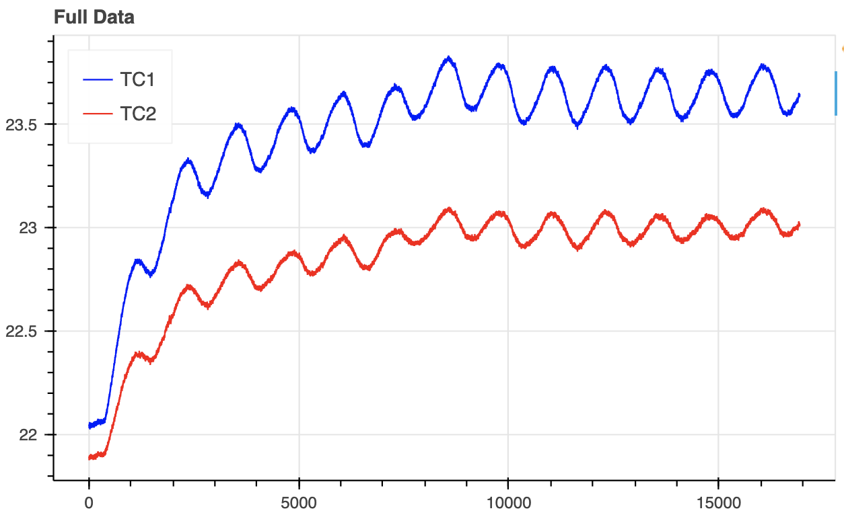
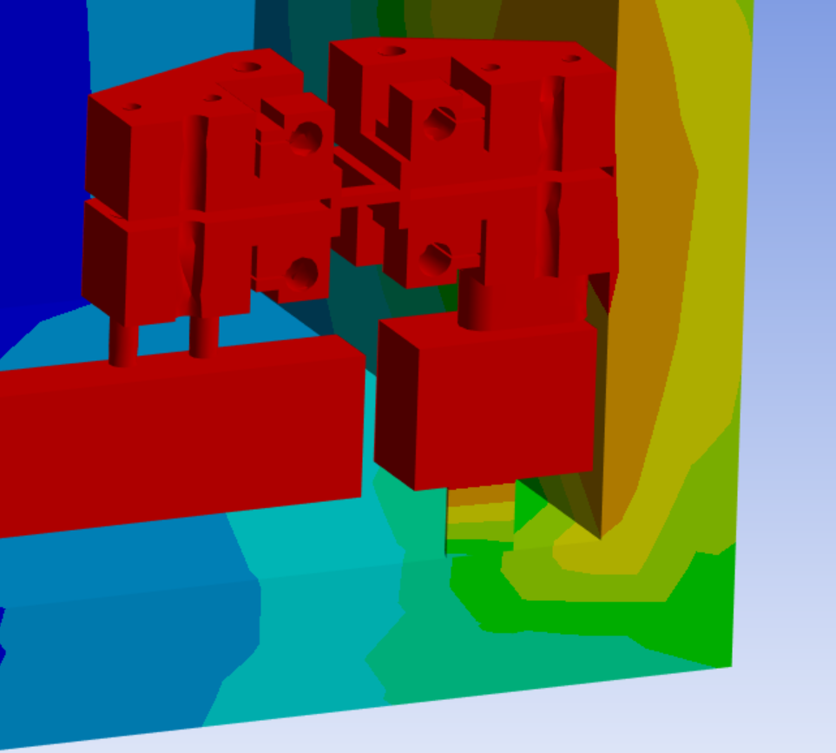
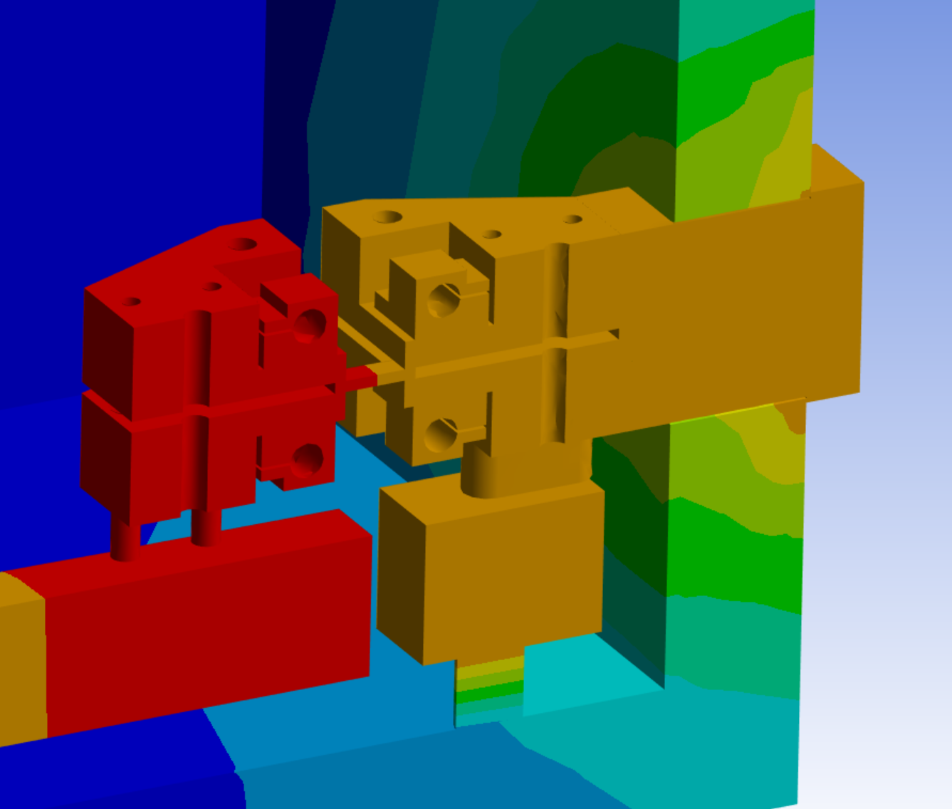
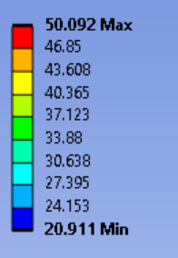
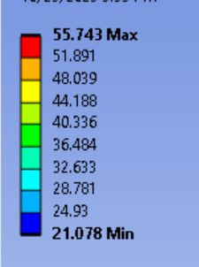
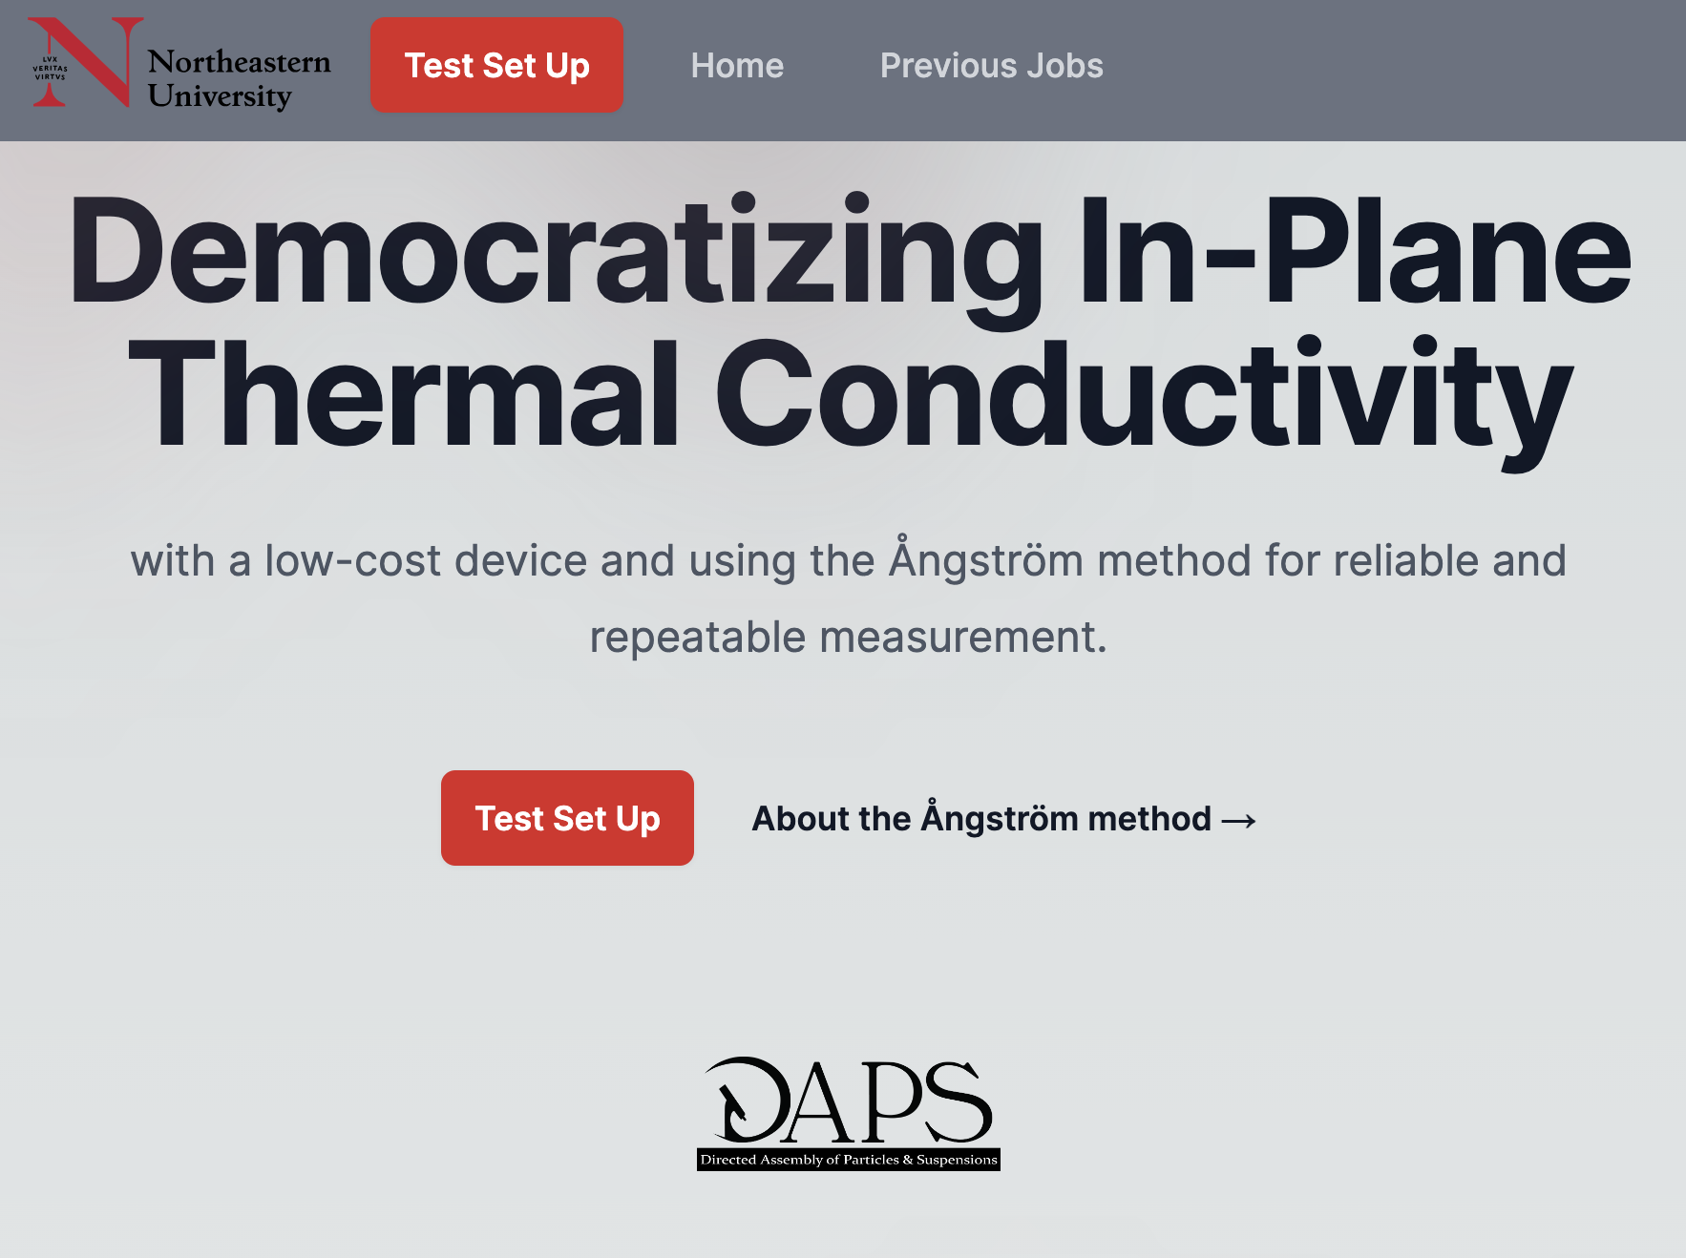
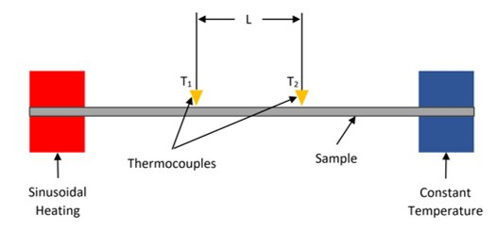
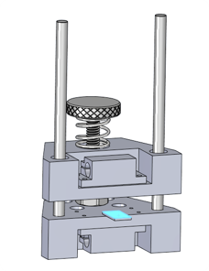
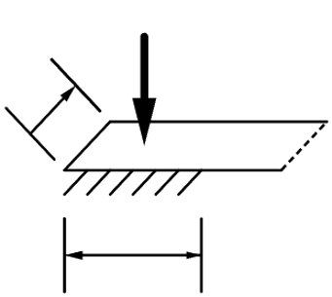
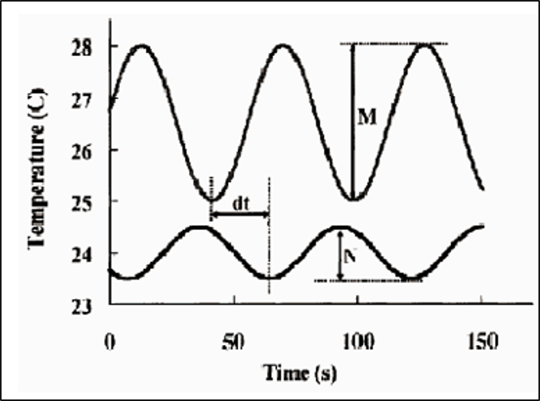
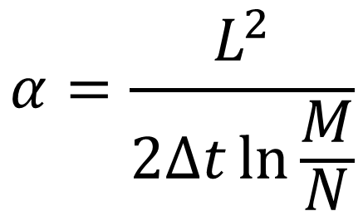
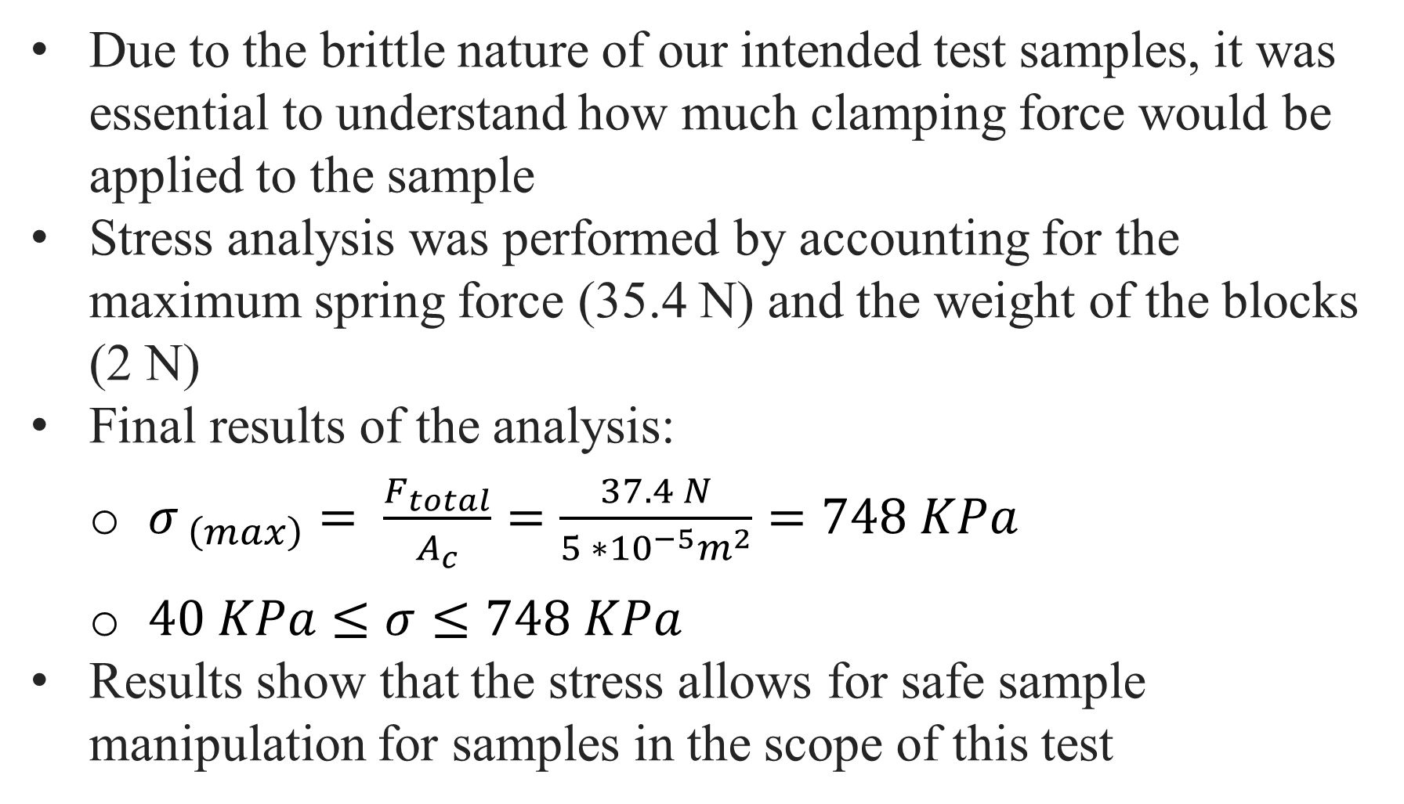
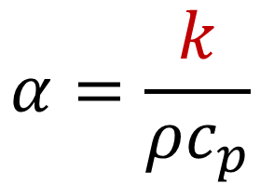
Democratizing In-Plane Thermal Conductivity
The Angstronomers:
Jordan Abi Nader, Aaron Leach, Charlie Schatmeyer, Rocco Tropea, Ben Veghte
Advisor:
Prof. Randall Erb
Background (Motivation)
Design Overview and Challenges
Design Validation
Researchers are trying to create new materials for low-profile thermal management solutions, which can only be characterized via in-plane thermal conductivity measurements.
Thermocouple Arms
Electrical Passthrough
Creating a robust testing platform for the Ångström method presented several key challenges:
Thermocouples – Maintaining equal mechanical contact between the 2 arms
Clamps – Holding brittle samples in place without fracture
Thermal Passthrough – Allowing heat to safely exit the vacuum chamber to maintain constant temperature
Heaters – Simulating a sinusoidal heat curve
Electrical Passthrough – Wiring electronics into the chamber without compromising vacuum
The thermocouple arms can each maintain a constant force of 0.14 N with no weights added. The clamps can secure brittle samples without fracture, and no fracture is caused through bending when the thermocouples are placed on a clamped sample.
We found the vacuum chamber to lose vacuum at a rate of 0.85 kPa/min. Solutions including use of vacuum grease and a control-loop-regulated vacuum pump can mitigate this slow leakage.
Full-scale tests have proven the validity of our system. In our initial test, we measured the thermal diffusivity of aluminum with 8.05% error. We expect to get stronger results in further tests with longer timescales, a higher amplitude of temperature change, and running under vacuum pressure.
Thermal Passthrough
Clamps
Galaxy Note 7 Victim of Poor Thermal Management
Vacuum Chamber
Current characterization equipment options are prohibitively expensive; the Ångström method provides a potential route to democratize in-plane thermal conductivity.
Heaters
Problem Statement
Heat Flow Simulation
Temperature (°C)
To democratize access to in-plane thermal conductivity testing by designing a cost-effective and reliable device using the Ångström method.
No Thermal Passthrough
With Thermal Passthrough
Vacuum Chamber – A Solution Amid a Problem
  Solution: Removes convection to improve accuracy of our results
  Problem: Removes ability to dissipate heat passively to maintain constant temperature
Without a thermal passthrough, the clamping would warm up too much and the acrylic of the vacuum chamber would soften
With the thermal passthrough, the box stays ~8°C cooler, and the clamps stay at a steadier temperature
Time (s)
Thermocouple readout from test of aluminum sample
The Ångström Method
Website & Inclusive Design Features
Our design measures in-plane thermal conductivity using the Ångström method. A thin sample is heated sinusoidally on one end and kept at a constant temperature on the other end. Along the sample, 2 thermocouples with a known separation distance L record the temperature as heat travels across the sample. If heat moves 1-dimensionally through the sample, the amplitude and phase shift of the thermocouple measurements can be used to compute the thermal diffusivity of the sample material, which can then be used to calculate thermal conductivity.
Our web app serves as both a front-end for running tests and an explanation of our device and the Ångström method. We’ve put care into ensuring the device is easy for any researcher to use.
Temperature (°C)
Temperature (°C)
Our economic device allows thermal measurement to be more accessible to research teams, and our website allows for simple operation and understanding of such a device. These efforts have successfully democratized the Ångström method.
Clamping Force
Due to the brittle nature of our intended test samples, it was essential to understand how much clamping force would be applied to the sample
Stress analysis was performed by accounting for the maximum spring force (35.4 N) and the weight of the blocks (2 N)
Final results of the analysis:
      $σ_{ \left(max\right)}= \frac{F_{total}}{A_{c}}=\frac{37.4 N}{5 ∗{10}^{−5}m^{2}}=748 KPa$
      $40 KPa≤σ≤748 KPa$
Results show that the stress allows for safe sample manipulation for samples in the scope of this test
Landing Page of the Device’s Web App
10 mm
Future Work / Exit Strategy
With the feedthroughs, the vacuum chamber can hold vacuum on its own, but not for the duration required for a typical test. This could be improved through leak testing.
Our device will be handed over to the Northeastern DAPS laboratory, where it will be used for materials testing of thin-film composites. We have high hopes for this device to standardize the use of the Ångström method as the lab researches the best parameters to run the test at to achieve the greatest accuracy. This will open the door for more labs to use the design and technology we created.
Diagram of Ångström method setup
$$α=\frac{L^{2}}{2∆t\ln{\frac{M}{N}}}$$
$$α=\frac{k}{ρc_{p}}$$
5 mm
Acknowledgements
Thermocouple readout
Special thanks to the Northeastern DAPS Lab, Prof. Erb, Evan Toth, José Martinez, Prof. Hashemi, and everyone involved in running Capstone.

