Slide 1

Democratizing In-Plane Thermal Conductivity
The Ångströnomers: Jordan Abi Nader, Aaron Leach, Charlie Schatmeyer, Rocco Tropea, Ben Veghte
Advisor: Professor Randall Erb
Notes:
Aaron

Slide 2
Problem Statement
To democratize access to in-plane thermal conductivity testing by designing a cost-effective and reliable device utilizing the Ångström method
Notes:
Aaron
Say “we’ll define these terms in the coming slides”

Slide 3
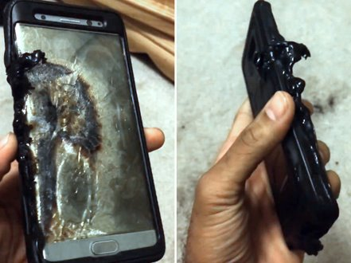
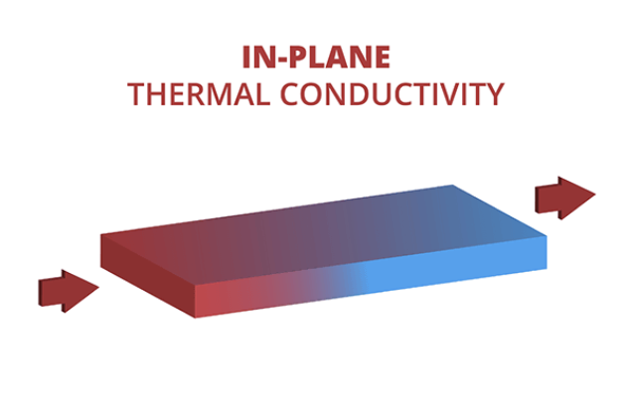
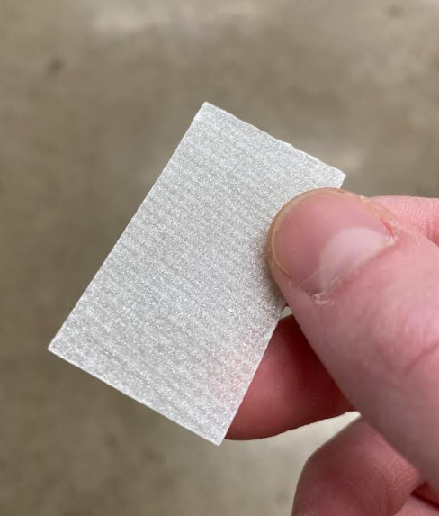
Motivation
Thermal management has reached a bottleneck in electronics and telecommunications industries
  Low-profile electronics require in-plane solutions
Novel, anisotropic materials being developed to dissipate heat in-plane
  Need a way to characterize them
Devices on the market for characterization are prohibitively expensive with insufficient accuracy
Novel, anisotropic coating from DAPS Lab
Notes:
Rocco
Thermal management “bottleneck”, not “barrier”

Slide 4
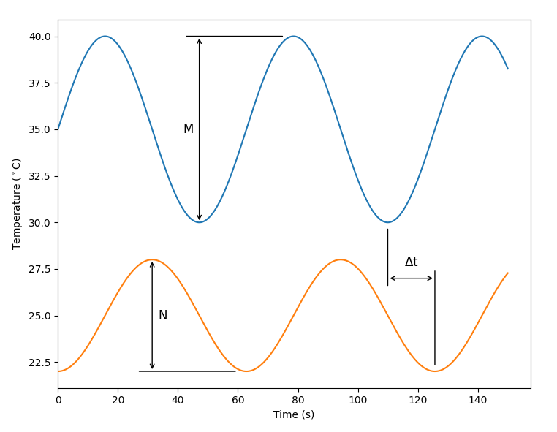
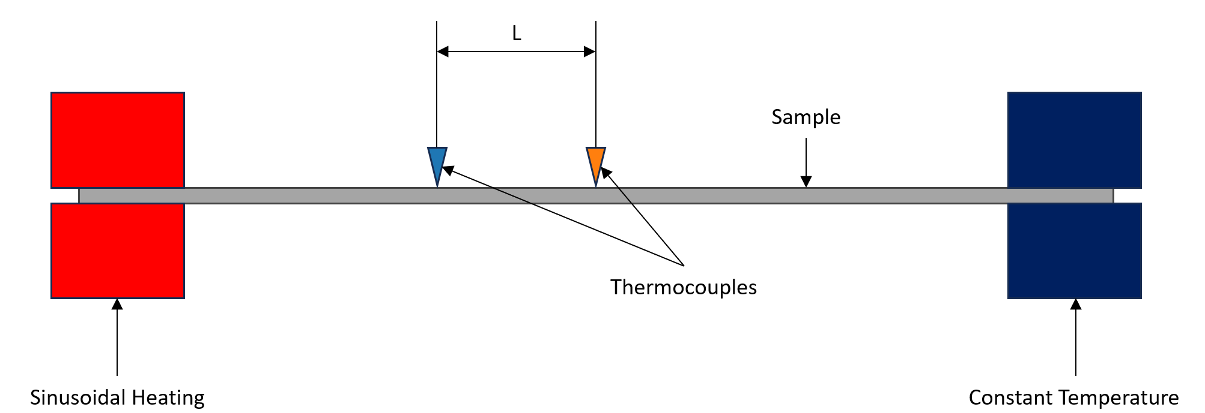
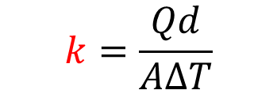
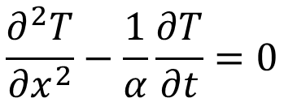
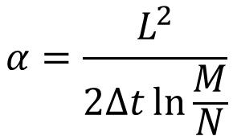
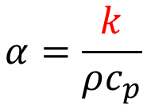
The Ångström Method
Our theoretical backbone
Thermal conductivity - The degree to which thermal energy is transported across a temperature gradient
$$k=\frac{Qd}{A∆T}$$
Q = Heat transferred
d = Distance between two isothermal regions
A = Area
ΔT = Change in temperature
$$\frac{∂^{2}T}{{∂x}^{2}}−\frac{1}{α}\frac{∂T}{∂t}=0$$
Relies on the validity of the 1-D Heat Equation:
Thermocouple Readout
Basic Setup
$$α=\frac{L^{2}}{2∆t\ln{\frac{M}{N}}}$$
$$α=\frac{k}{ρc_{p}}$$
Notes:
Rocco

Slide 5
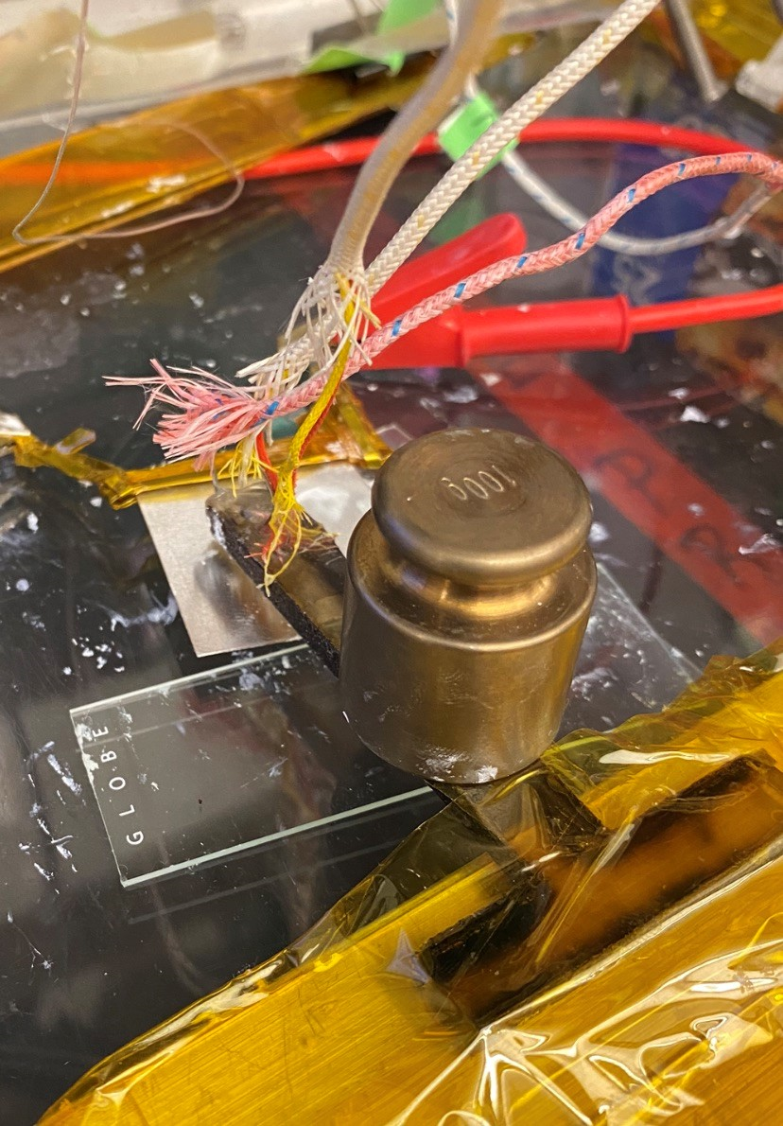
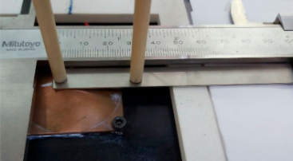
Prior Work
Current implementations of the Ångström method lack mechanical robustness for highly repeatable testing, with many inconsistencies between labs
W.-H. Zhang, et. al, Energies, vol. 12, no. 22, p. 4238, 2019, doi: 10.3390/en12224238.
Wen-Hua Zhang
(National Tsing-Hua University, Taiwan)
Evan Toth
(Northeastern DAPS Lab)
Notes:
Rocco
Finish with “there is lab-to-lab variability”

Slide 6
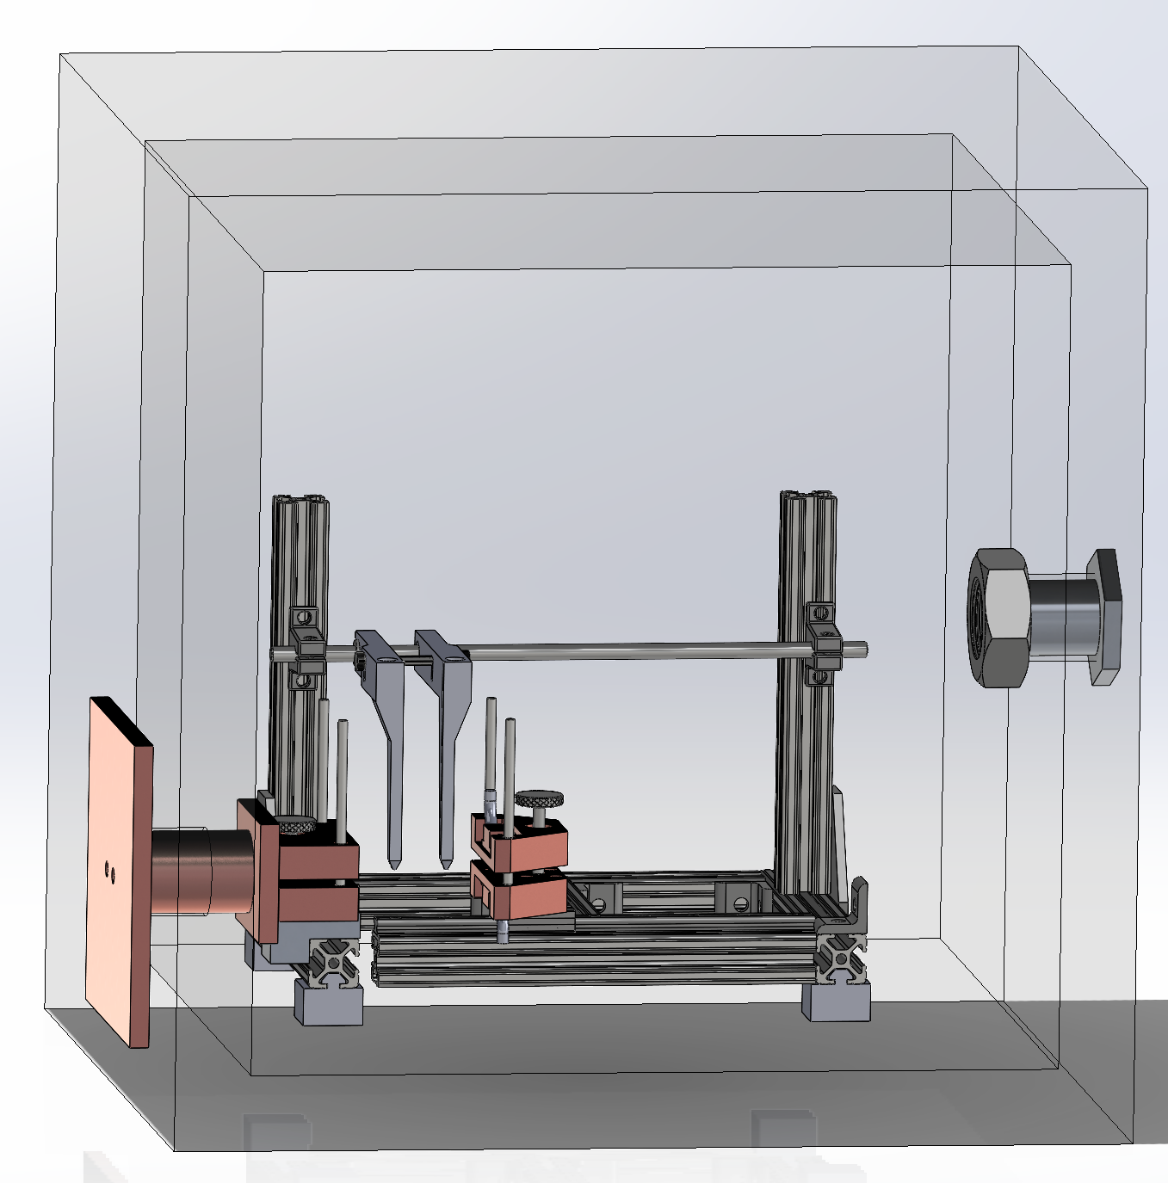

Our Design
Vacuum Chamber
Thermocouple Arms
Electrical Feedthrough
Controls/Webserver
Thermal Feedthrough
Clamps
Electric Heaters
Team responsibilities were organized around subsystem challenges
Notes:
Ben. KEEP MY SLIDES WITHIN 1:30
Use this slide to discuss the test setup steps.
Our solution pictured behind me, hopes to reduce that variability. To run the test, the user inserts the sample between the clamps, that provide a repeatable clamping force using springs and spacers. The thermocouple arms are then lowered onto the sample and held in place by gravity and optional weights. The user then goes to the computer connected to the thermocouples and electric heaters through the electronic feed through to begin the test. On the website the user and is able to set test parameters, and monitor and interact with the results and live data, no coding required.

Slide 7
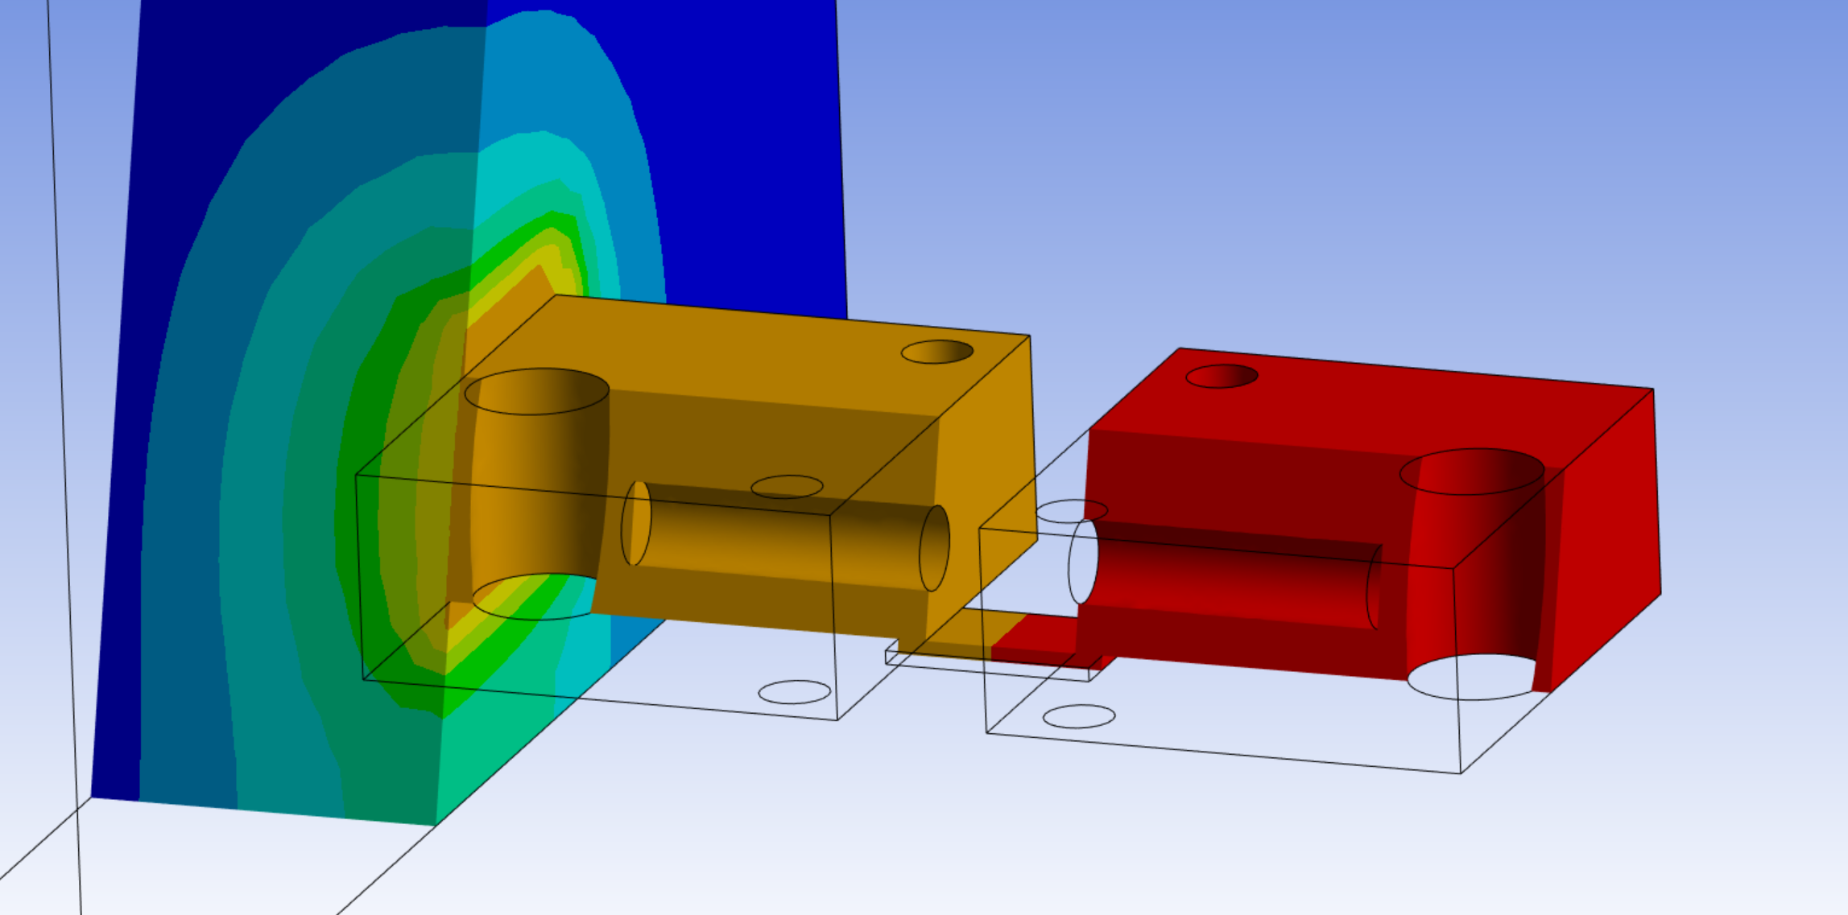
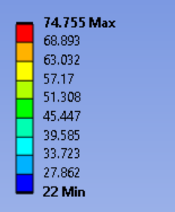
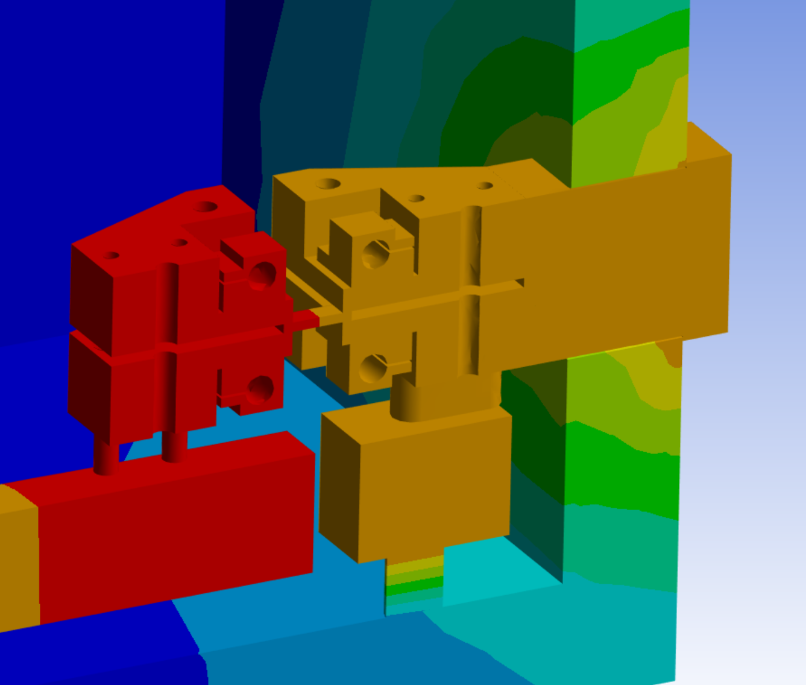
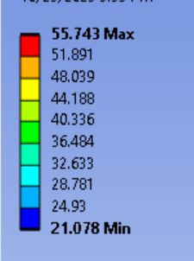
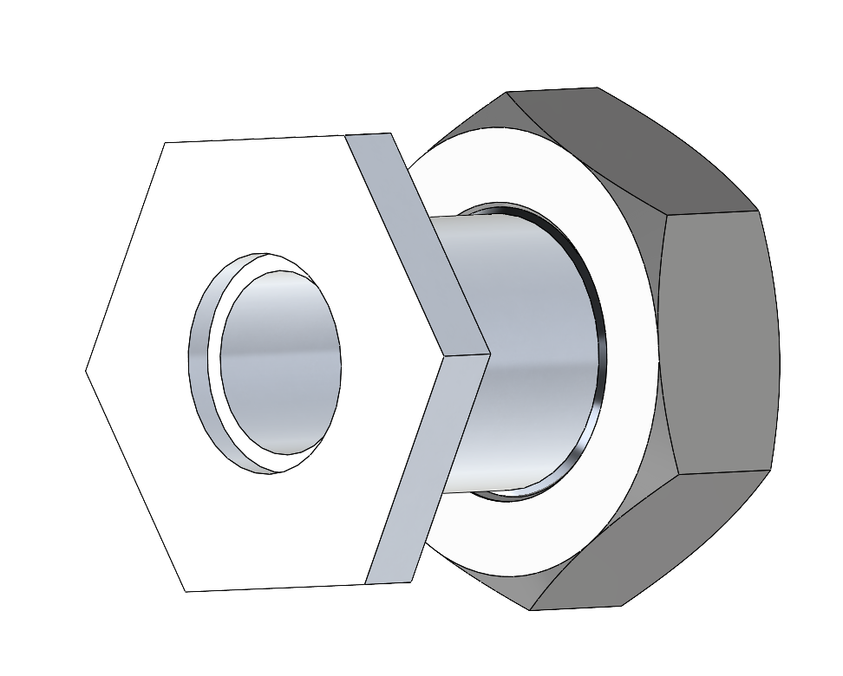
Design Challenges & Solutions
Vacuum Chamber – Both a solution and a problem
  Increases overall system accuracy by reducing impact of convection on sample temperature
  Makes it difficult to remove the heat from the system
ANSYS simulations to improve and verify our designs to keep one side of the fixturing a steady temperature
Vacuum chamber also posed a challenge for running wires out of the box
  Designed a custom wire feedthrough for heaters and thermocouples
Notes:
Ben
One of the biggest challenges we faced was with the vacuum chamber. It enhances the overall accuracy of the system by removing the convection which is unaccounted for in angstrom method, and therefor can interfere with accurate results. However, it also prevents us from dissipating the heat that is flowing through the sample and into the constant temperature clamps, and maintaining a constant temperature on those is extremely important. Using Ansys, we simulated each of our designs from the very earliest concepts in the top right, to what we settled on in the bottom right and many versions in between to educate our iterations to ensure that we were going to be able to mainatin a constant temperature and not overheating the vacuum chamber walls. We also needed to run many wires through the wall of the chamber, so we had to design a custom electrical feedthrough to keep the box sealed while getting the signal and power wires out.

Slide 8
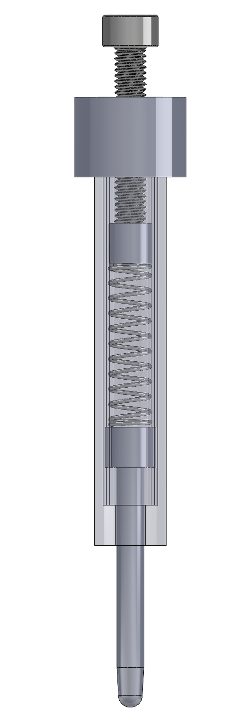
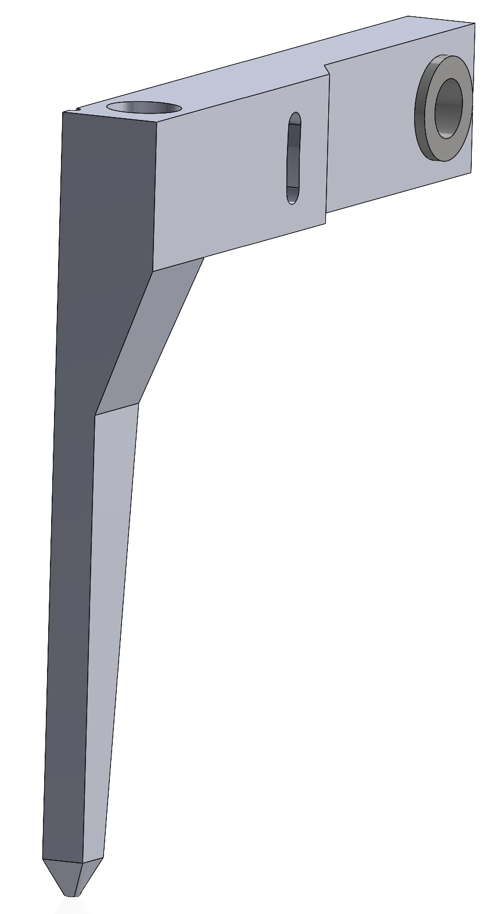
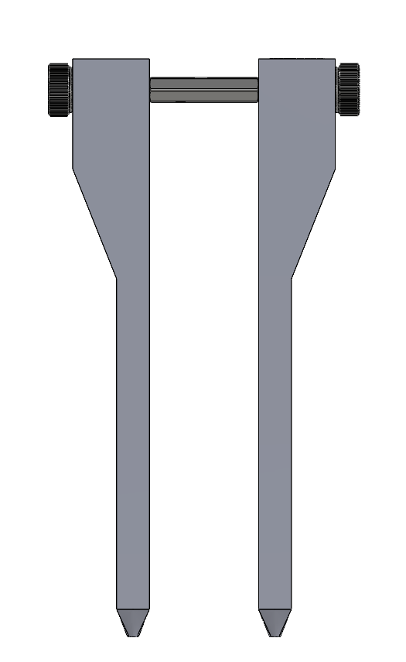
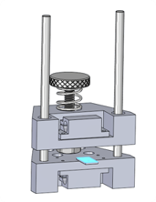
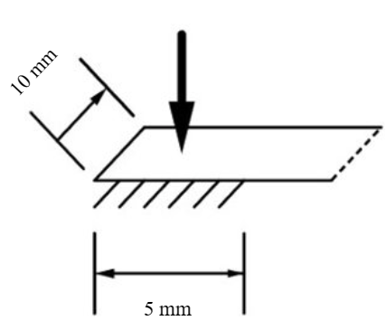

Design Challenges & Solutions
L
Thermocouple Arms – Maintaining equal contact pressure on the sample + maintaining distance L
  Spring prototype had adjustment screw to change pressure → inconsistent
  Cantilever design takes advantage of weight to provide pressure
Clamps – Rigidly securing brittle samples without fracture
  Spring constant selected after performing stress analysis
V1: Spring
V4: Cantilever
Clamp weight only
Max compression
Contact area
Notes:
Aaron
Spring allows for gradual increase in force (fine-grain control)

Slide 9
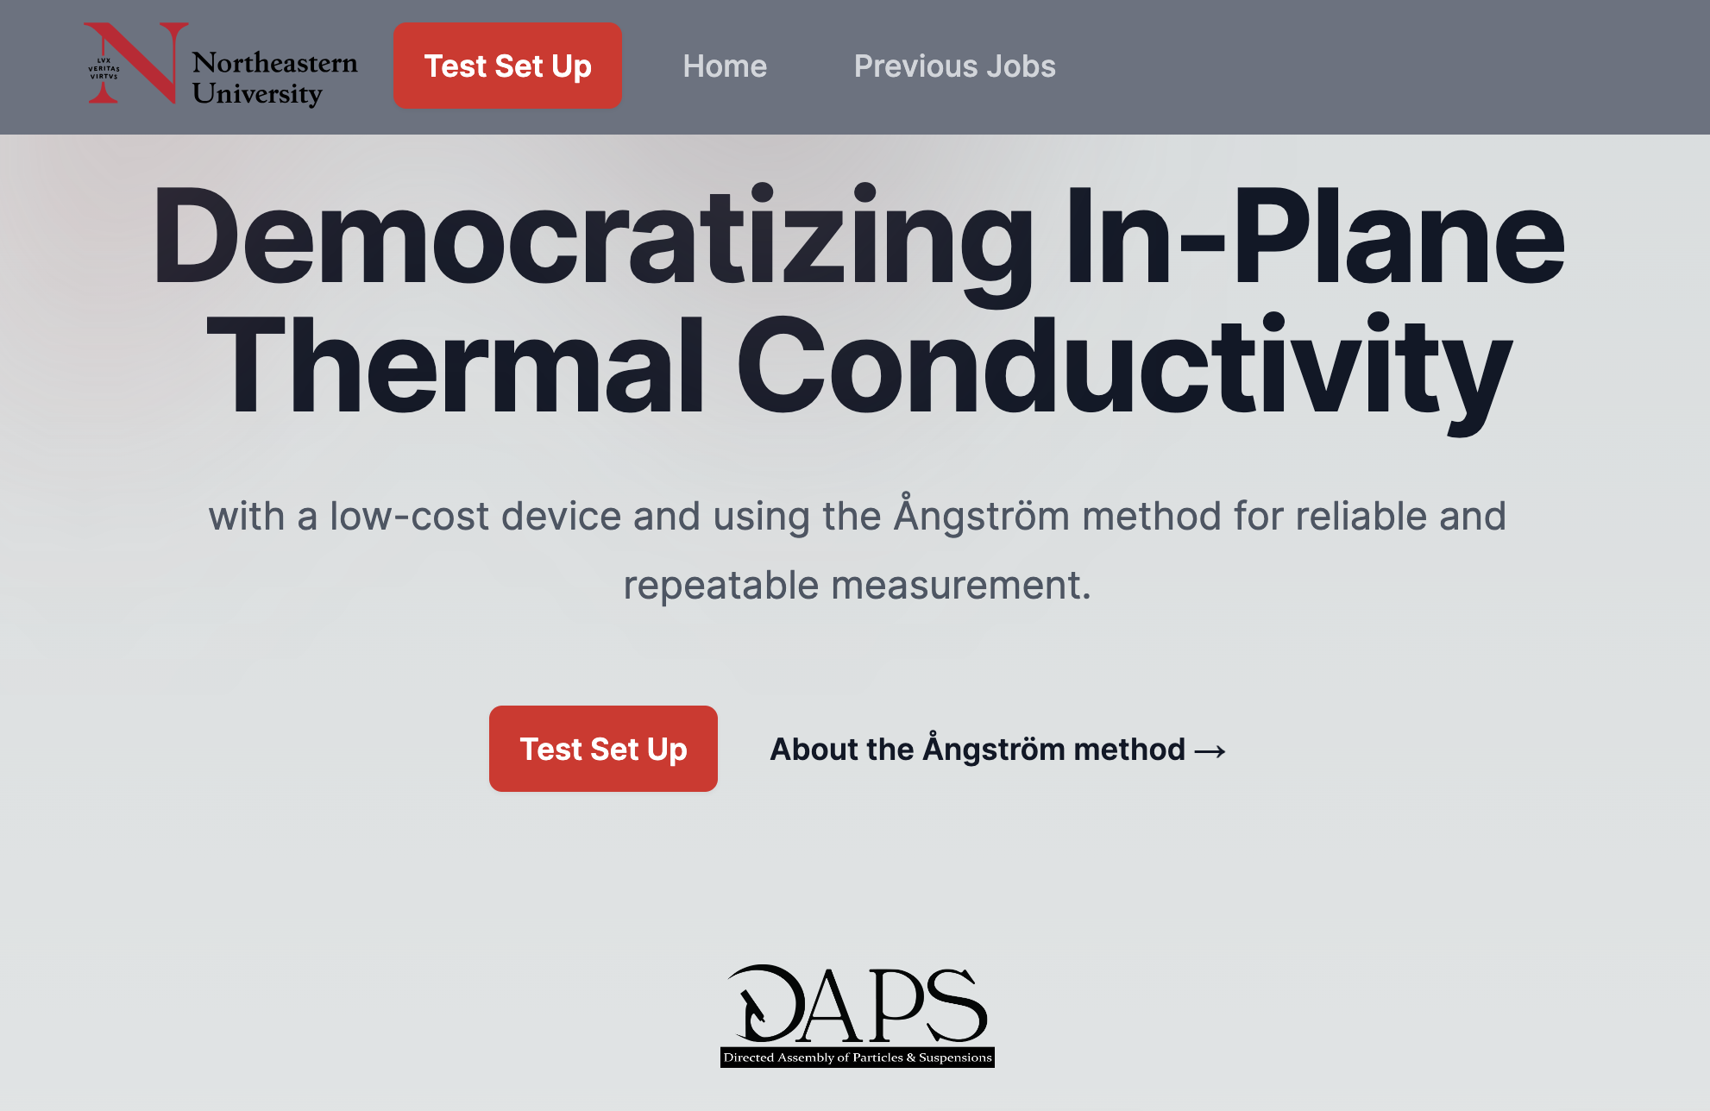
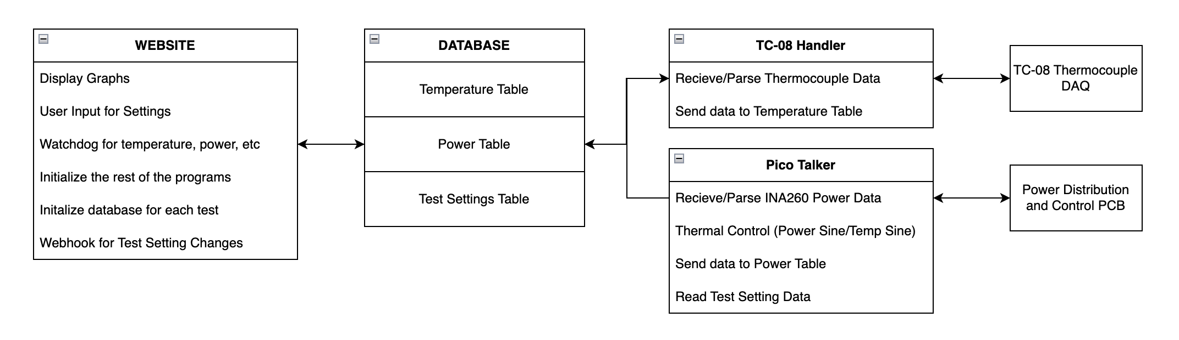
Design Challenges & Solutions
Inclusive, user-friendly front-end
  Fully embedded, no interaction with controls and electrical components
Solution: Next.js Web App with Python Backend writing to a SQLite Database
Features include:
  Learning module about the Ångström method and the procedure of this test
  Real-time control of parameters mid-test based on live data
  Interactive post-test analysis of collected data
Notes:
Jordan

Slide 10
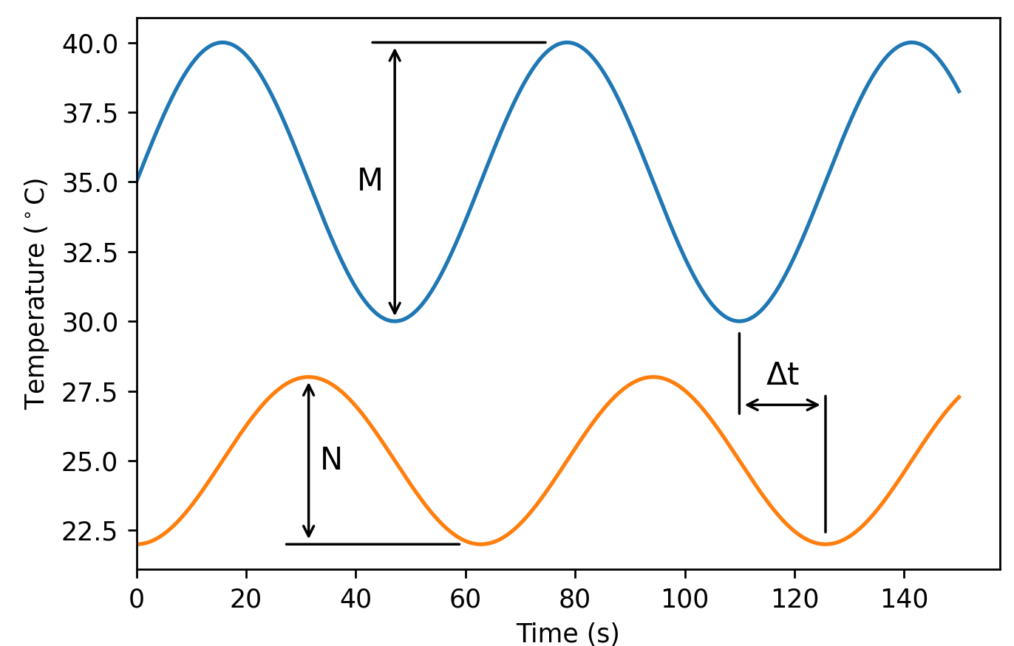
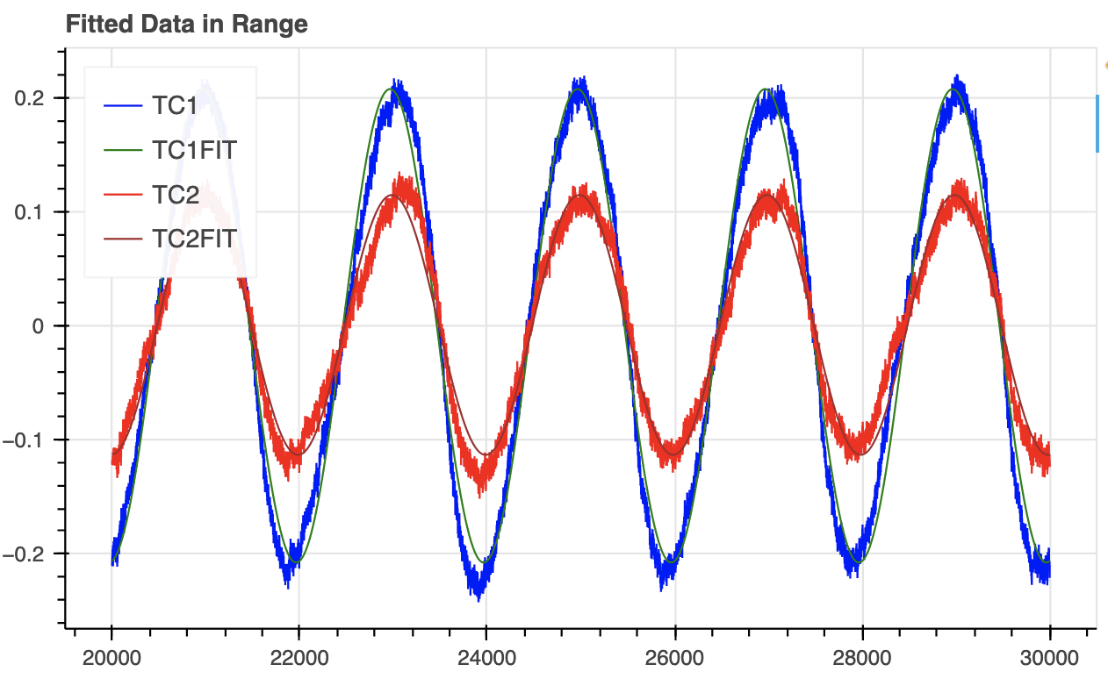
Results
Subsystem validation
  Thermocouples each maintain 0.14 N of constant force
  Heaters approximate sine wave temperature fluctuation
4-hour test measured thermal conductivity of aluminum with 8.05% error
12-hour test measured thermal conductivity of zinc with 3.23% error
  Stronger results expected with vacuum pressure
Temperature Fluctuation (°C)
Time (s)
Notes:
Jordan
(if needed, for first test stronger results expected under larger temperature fluctuation, longer timescale, and under vacuum pressure)

Slide 11
Exit Strategy
We have demonstrated the viability of the Ångström method in our design
But…
Our prototype is not the final step
  Improve maintaining of vacuum
  Discover optimal test parameters
Handoff to the DAPS Lab at Northeastern
  Will test thin-film polymer samples
  Optimize use of the device
  Publish research paper on optimal parameters
Notes:
Charlie

Slide 12
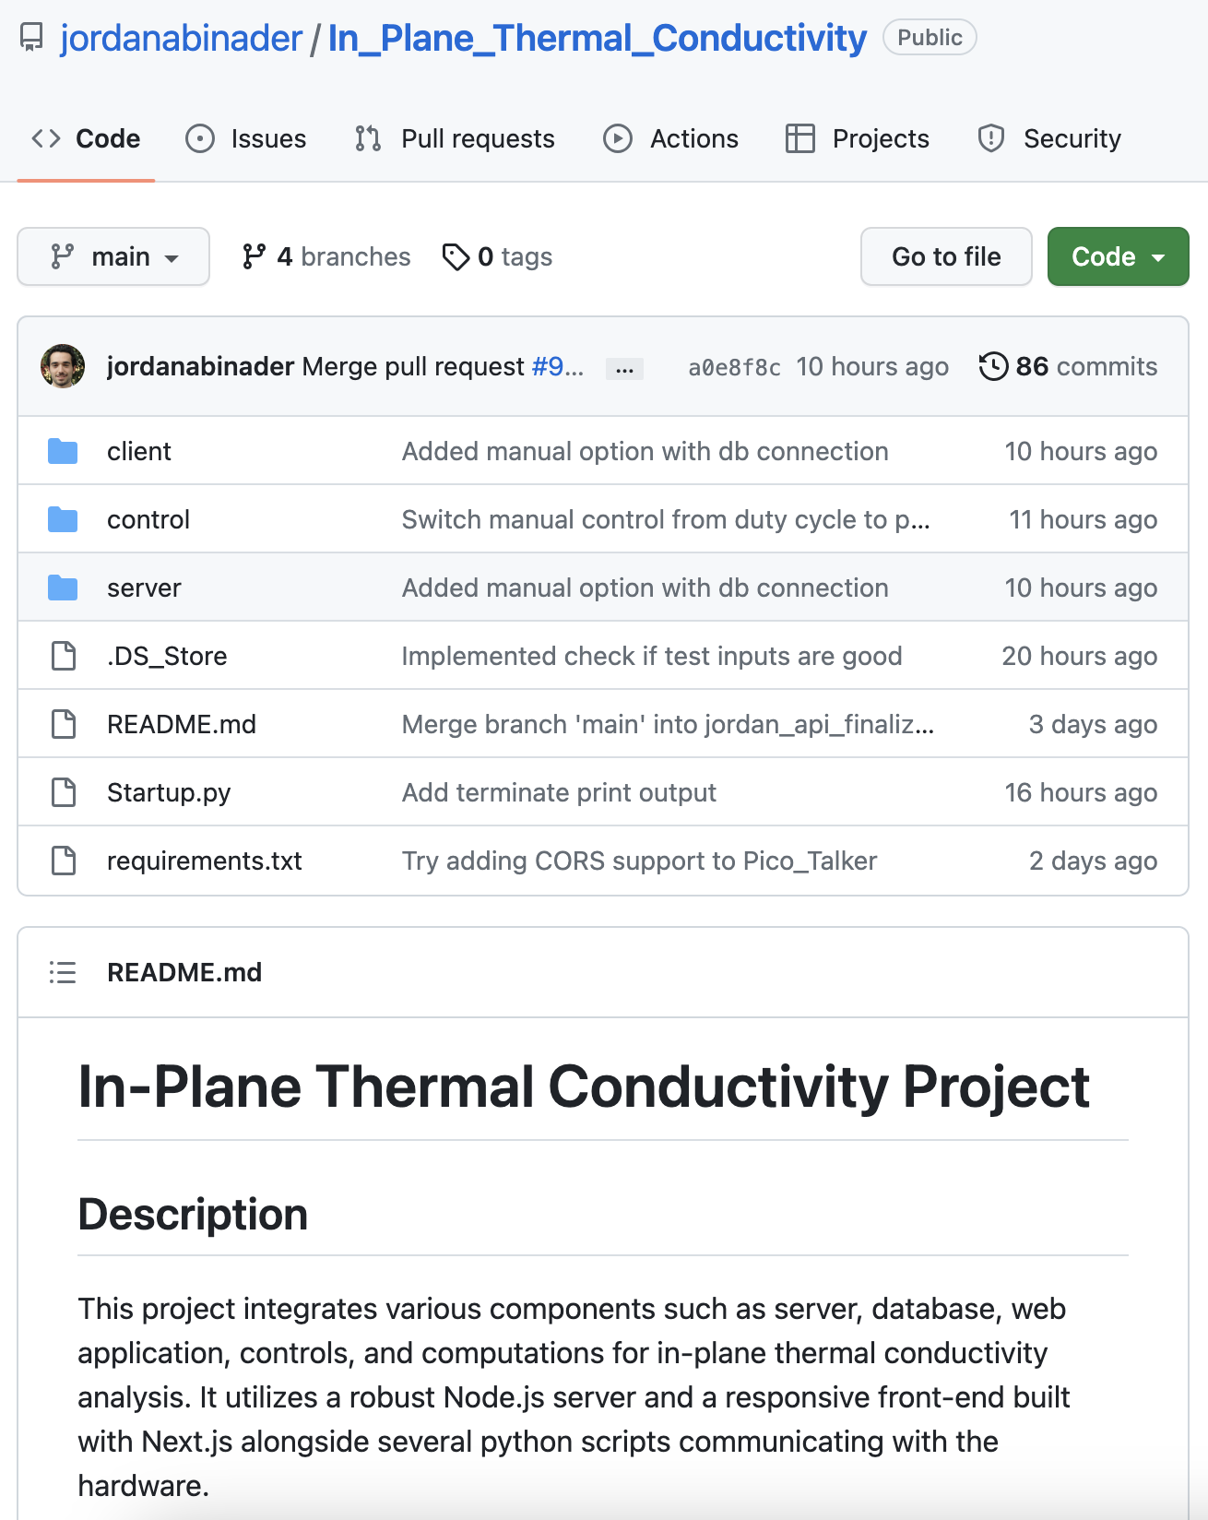
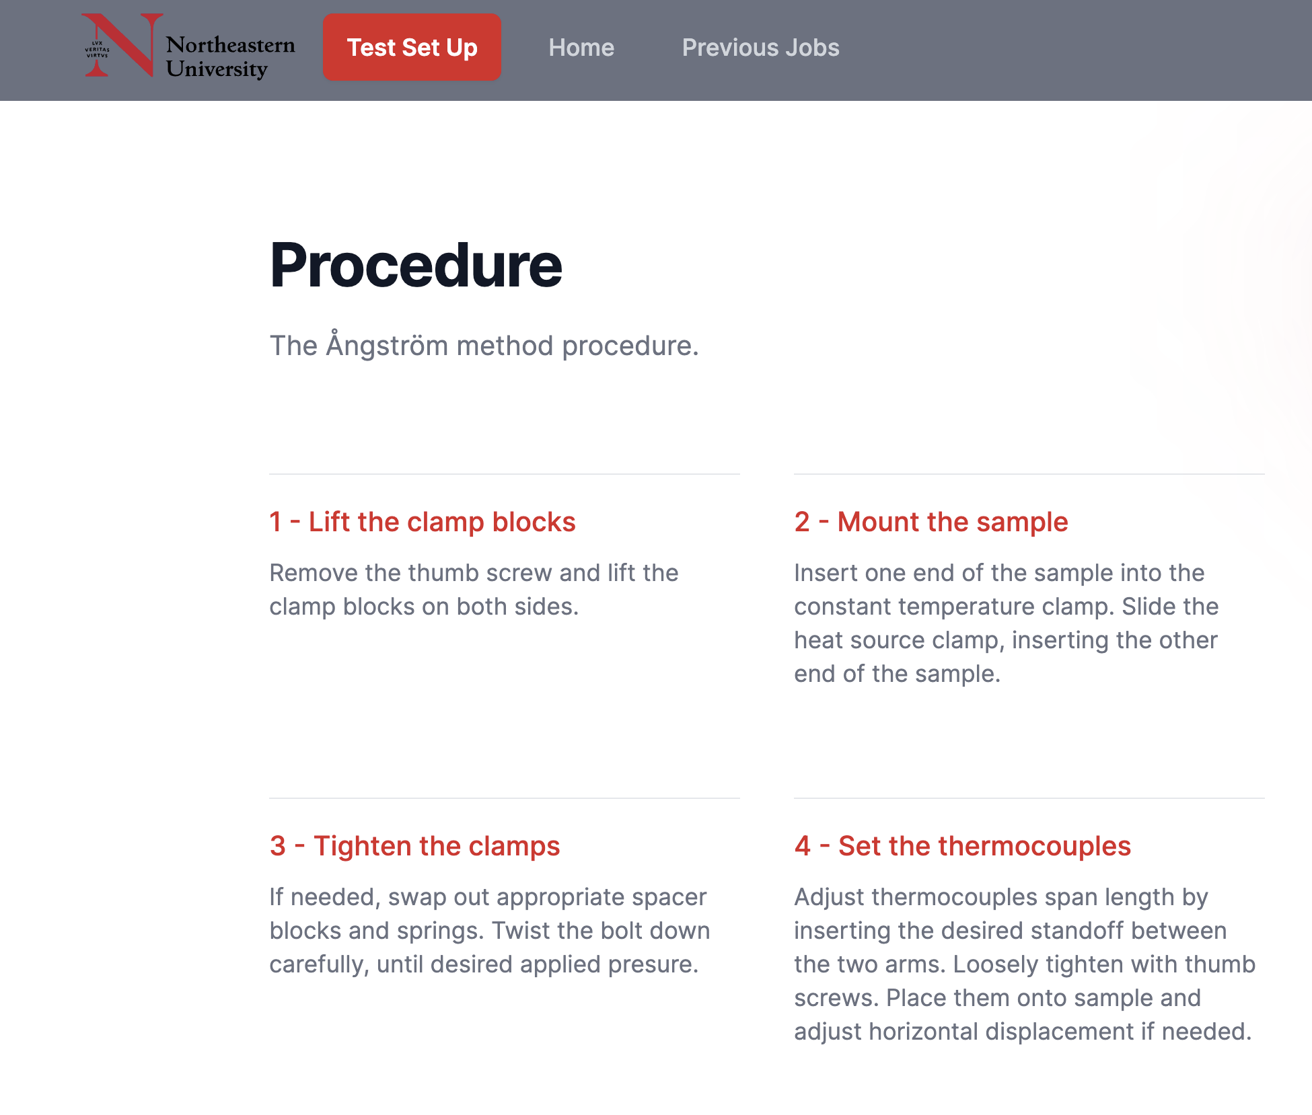
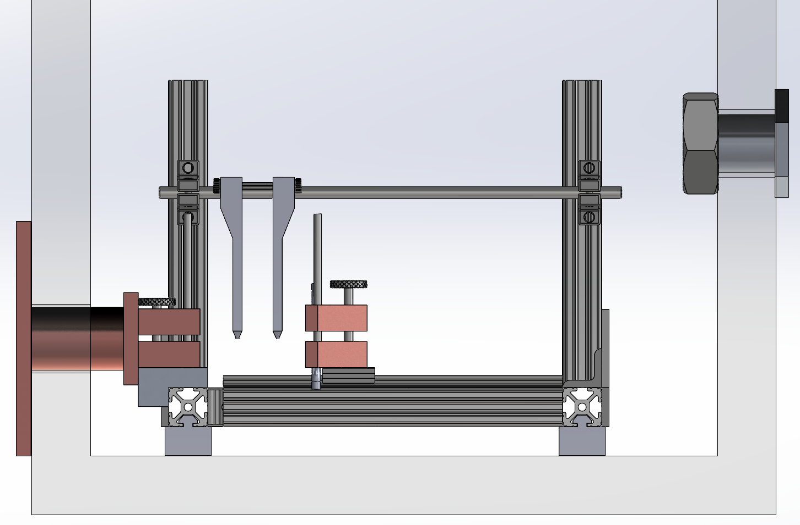
Future Work
Publish integrated codebase as public repository on GitHub
Work with DAPS Lab to produce technical publication that disseminates design to the academic world
Host version of website to educate people on the Ångström method
Notes:
Charlie
So that it can be shared amongst labs, standardized, democratize

Slide 13
Thank you!

